Slide 1

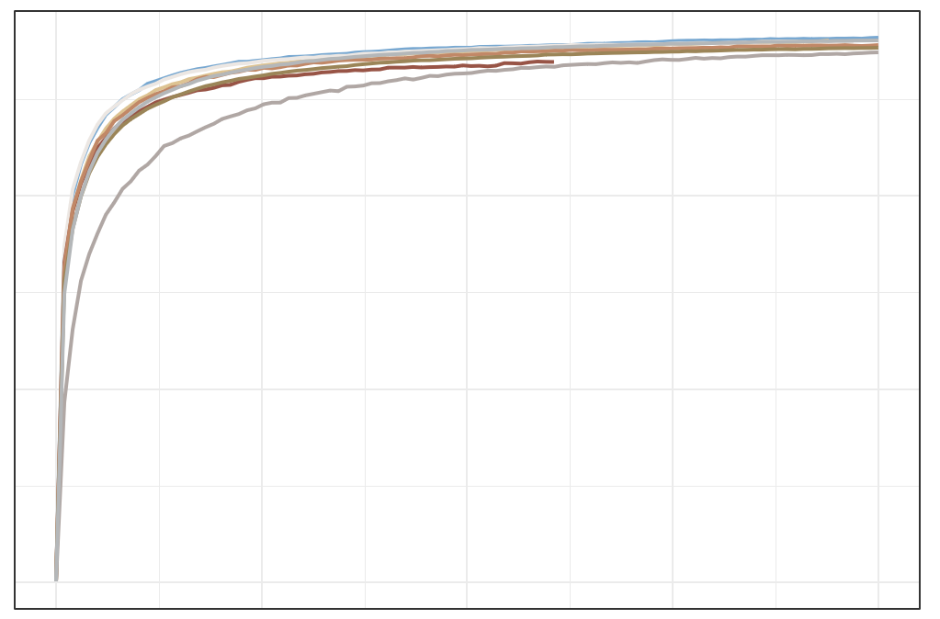

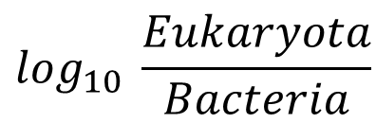
Raw Metagenome Sequencing Data Profile
a
$$Histogram for \log_{10} \frac{Micro−eukaryota}{Bacteria}$$
10
Histogram for log₁₀ Eukaryota
median = −2.80
Percentage
10
median = 4.31
8
8
6
Percentage
4
2
6
0
1
2
3
4
5
6
Histogram for log₁₀ Bacteria
4
Percentage
8
median = 7.19
6
4
2
2
0
4
5
6
7
8
0
−6
−5
−4
−3
−2
−1
$$\log_{10} \frac{Eukaryota}{Bacteria}$$
b
Sample sequence quality control
2,052 samples
filter history
surgery patients
1,986 samples
filter none
stage patients
1,919 samples
PCR free
1,837 samples
filter the low-alignment-reads sample (< 1M )
1,836 samples
Suspected contamination samples filtering
1,625 samples
filter suspected of eukaryotic
contamination
(1 species> 50%)
1,670 samples
filter suspected of bacteria contamination
(1 species> 50%)
1,739 samples
filter the
high-Eukaryota
sample (> 1% )
1,817 samples
filter the
low-Eukaryota sample (< 0.01% )
Low-eukaryotic sequencing depth selection
d
filter low eukaryotic
sequencing depth samples ( < 10k)
1,329 samples
chao1
400
c
2014_ZellerG
2015_FengQ 2016_VogtmannE 2019_Thom 2019_WirbelJ 2019_Yachida 2021_JunY_1
2021_JunY_2
Items | adenoma | CRC | CTRL | filter | leave
import samples | 453 | 641 | 743 | - | 1,837
filter low-align-reads samples | 453 | 641 | 742 | 1 | 1,836
filter low-Eukaryota samples | 448 | 633 | 736 | 19 | 1,817
filter high-Eukaryota samples | 435 | 597 | 707 | 78 | 1,739
filter suspected bacteria contamination samples | 418 | 577 | 675 | 69 | 1,670
filter suspected eukaryotic contamination samples | 409 | 561 | 655 | 45 | 1,625
filter low eukaryotic sequencing depth samples | 350 | 454 | 525 | 296 | 1,329
200
0
0
5000
10000
15000
20000
Sequencing Depth in Fungi
Notes:
F:\GitHub\multi-CRC-fungi\01.Histogram_data_profile
F:\GitHub\multi-CRC-fungi\04.RarefactionCurve\Cohort

Slide 2
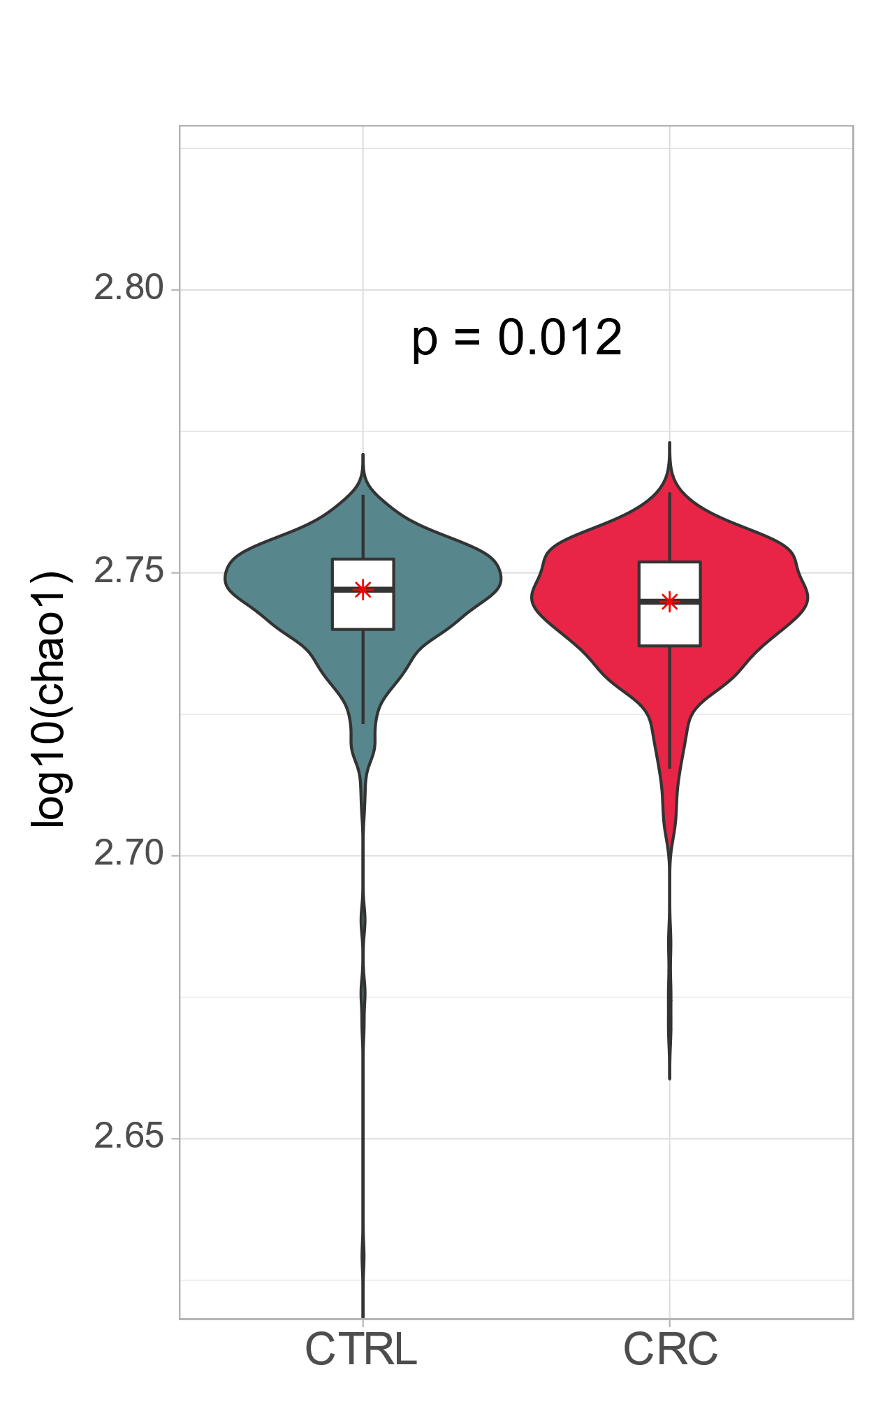
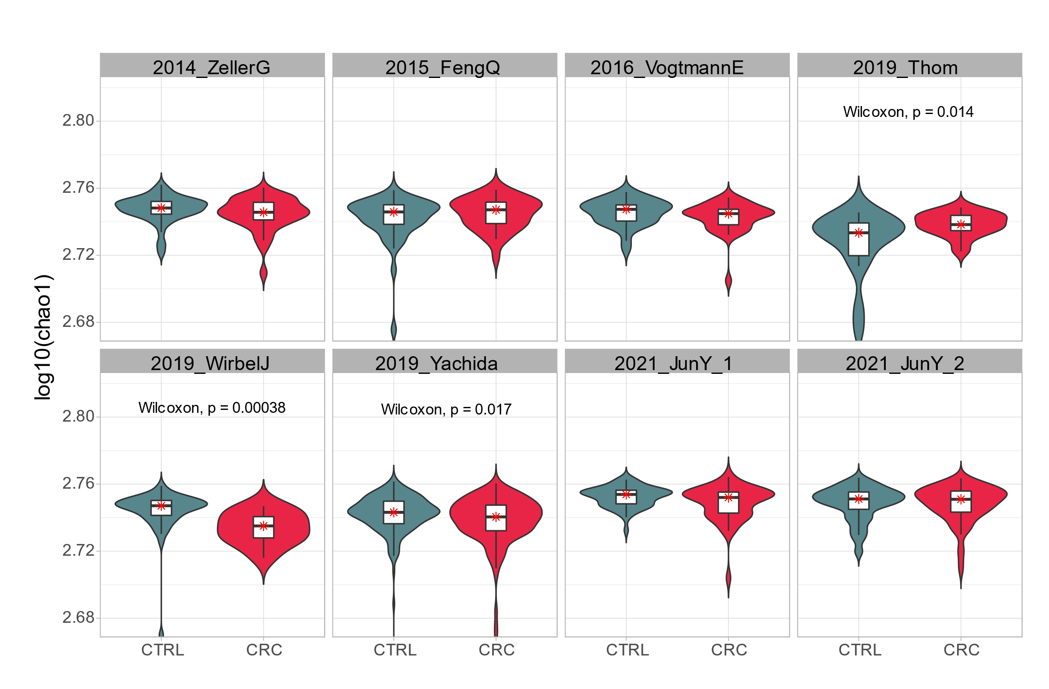
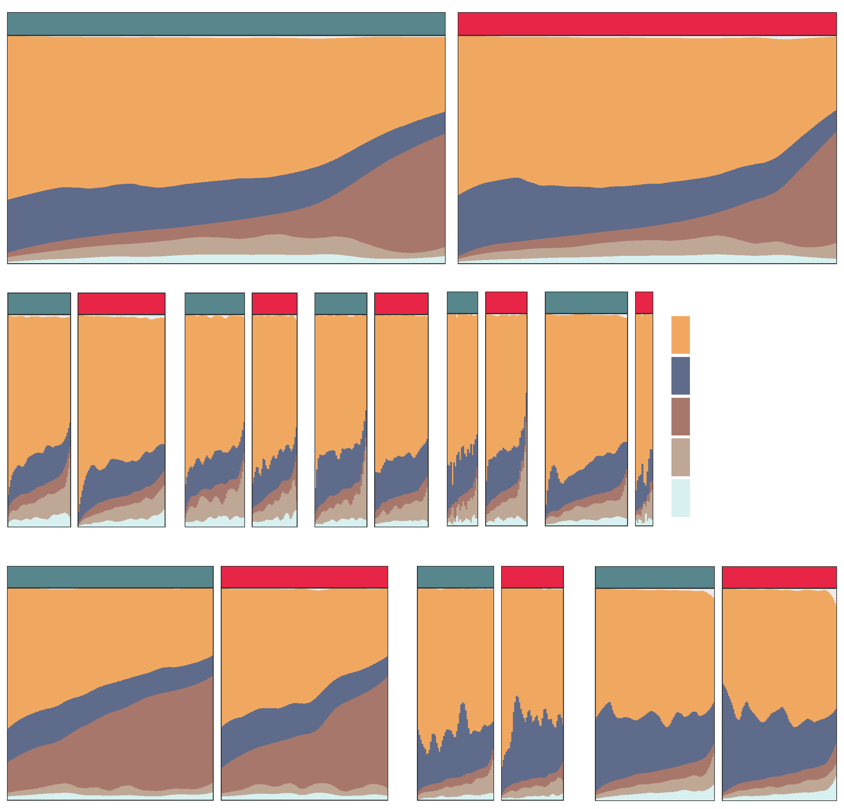
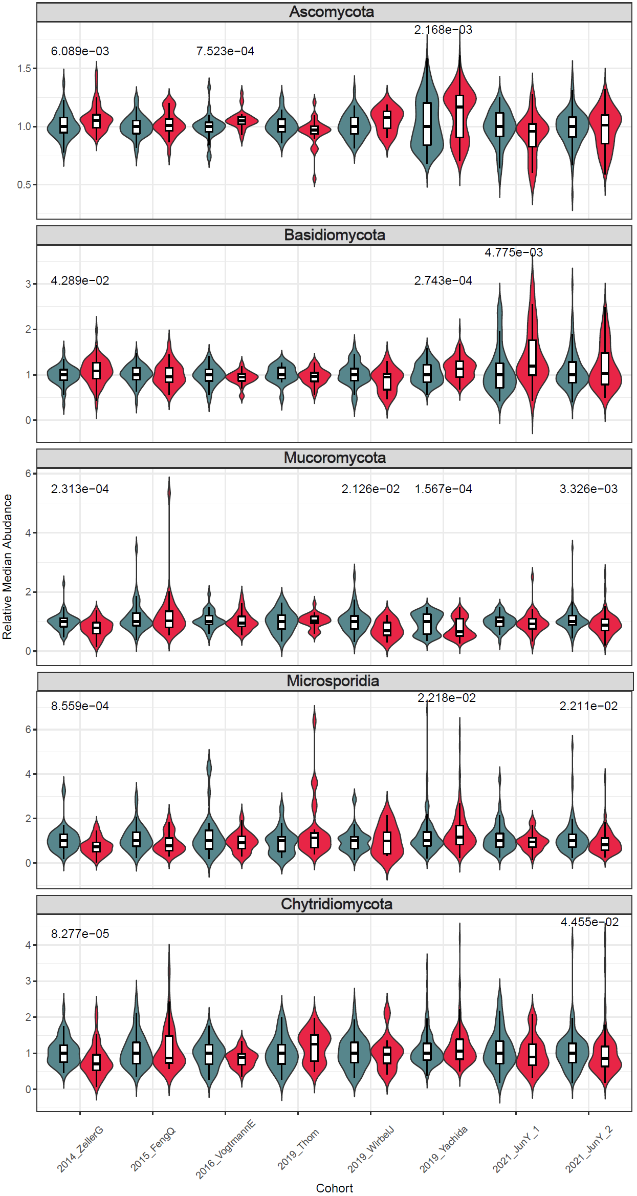
Alpha Diversity in Micro-eukaryotic level
a
b
Control
CRC
c
2014_ZellerG (EU)
2015_FengQ (OC)
2016_VogtmannE (NA)
2019_Thom (EU)
2019_WirbelJ (EU)
CORE PHYLUM
Control
CRC
Control
CRC
Control
CRC
Control
CRC
Control
CRC
Ascomycota
Basidiomycota
Mucoromycota
Microsporidia
Chytridiomycota
Control
2019_Yachida (AS)
CRC
2021_JunY_1 (AS)
2021_JunY_2 (AS)
Control
CRC
Control
CRC
Notes:
F:\GitHub\multi-CRC-fungi\06.AlphaDiversity\AlphaIndex\figure
F:\GitHub\multi-CRC-fungi\06.AlphaDiversity\Normaled_Median
F:\GitHub\multi-CRC-fungi\06.AlphaDiversity\Fungal_Components

Slide 3
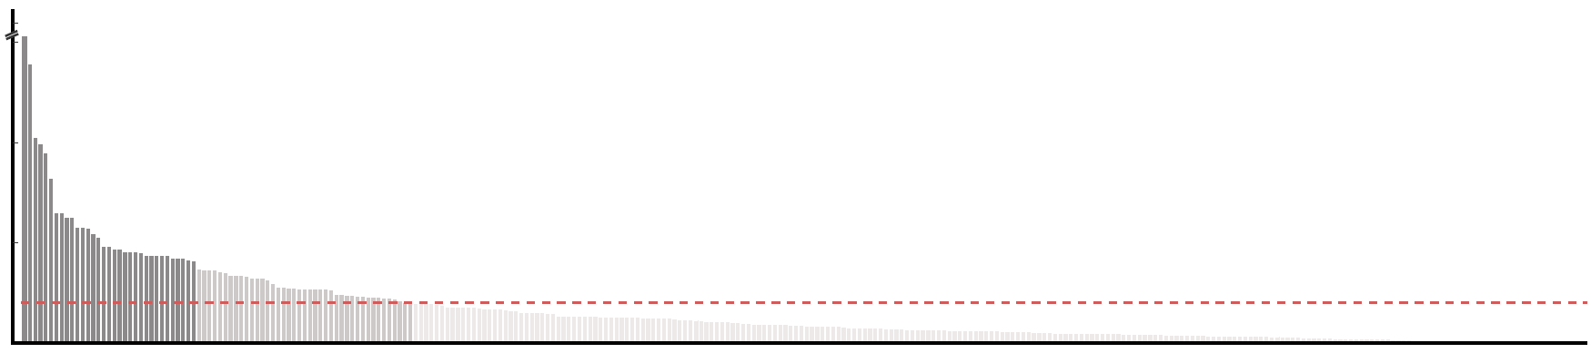
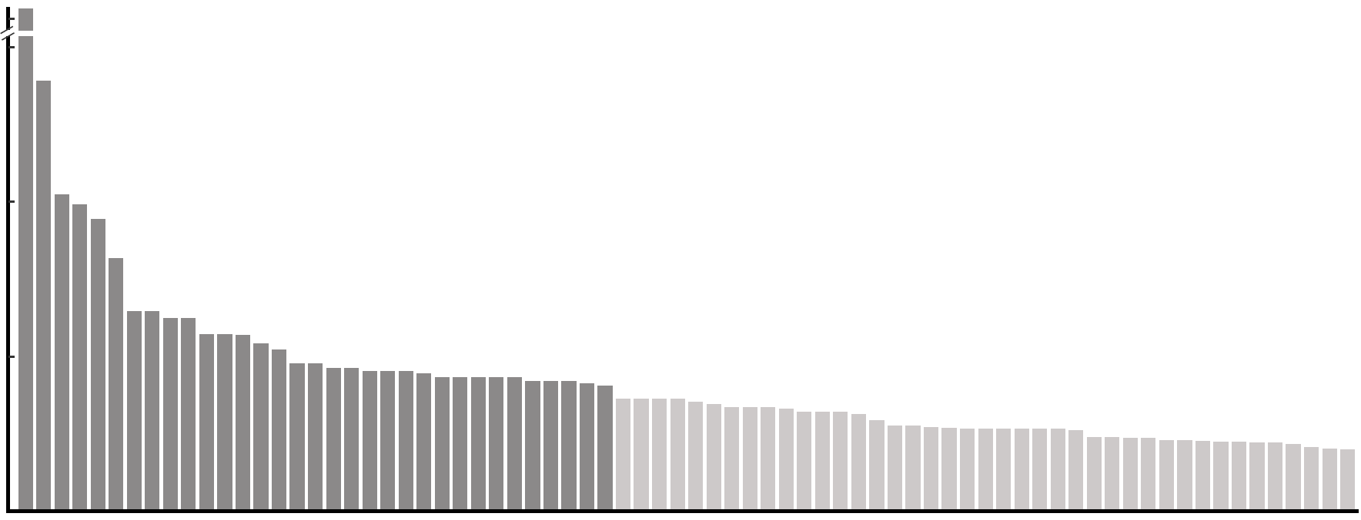
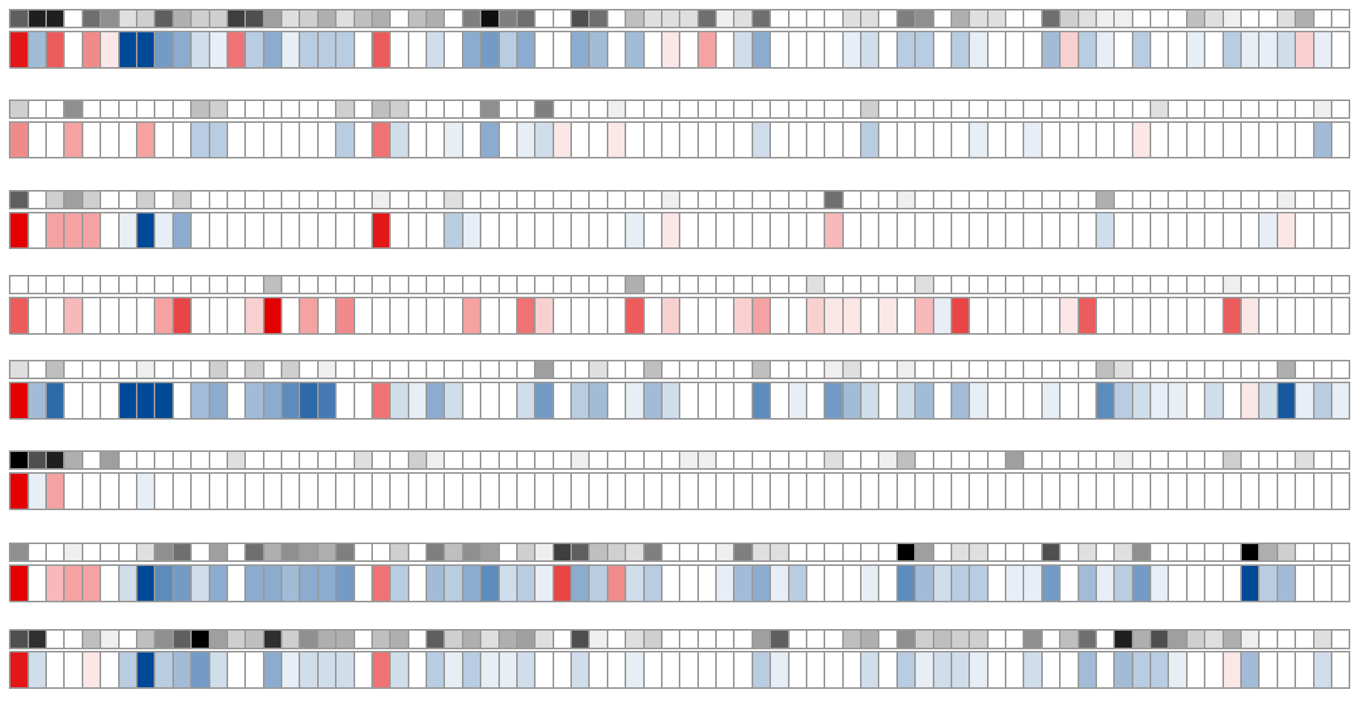
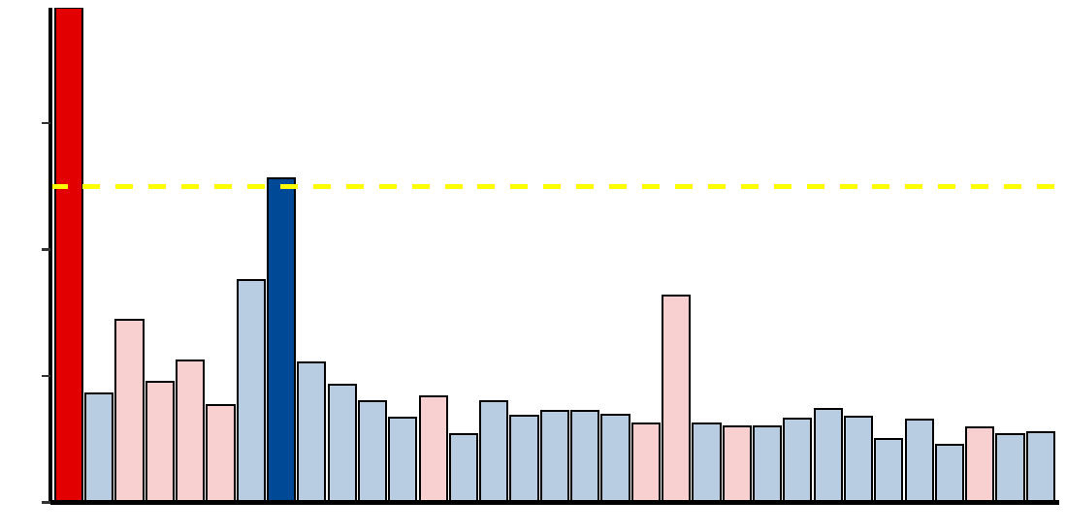
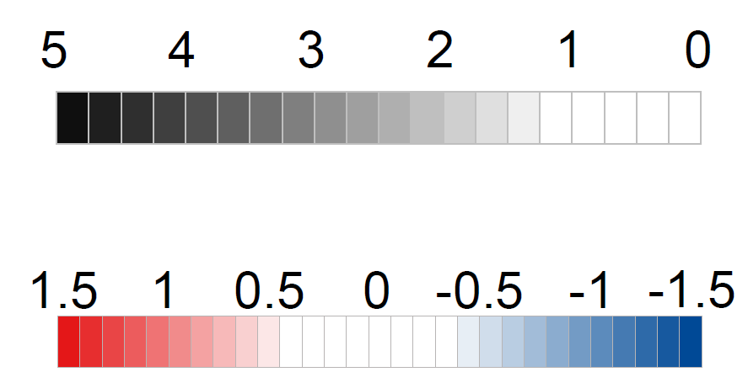
Micro-eukaryotic features selection
a
17.0
17.0
7.5
7.5
- log₁₀ FDR
5.0
- log₁₀ FDR
5.0
2.5
FDR < 0.1
0.0
2.5
FDR < 0.01
0.0
Aspergillus rambellii
Rhizophagus irregularis
Moniliophthora perniciosa
Erysiphe pulchra
Sphaerulina musiva
Phytophthora capsici
Trichophyton mentagrophytes
Aspergillus kawachii
Pneumocystis murina
Debaryomyces hansenii
Trichoderma atroviride
Pseudocercospora musae
Cordyceps sp. RAO−2017
Rhizophagus clarus
Pichia kudriavzevii
Paracoccidioides brasiliensis
Albugo candida
Lipomyces starkeyi
Naumovozyma dairenensis
Phytopythium vexans
Aspergillus ochraceoroseus
Colletotrichum fioriniae
Coniochaeta ligniaria
Leucoagaricus sp. SymC.cos
Colletotrichum salicis
[Candida] arabinofermentans
Baudoinia panamericana
Hyaloscypha variabilis
Schizosaccharomyces pombe
Tuber magnatum
Thielaviopsis punctulata
Edhazardia aedis
Choanephora cucurbitarum
Elsinoe australis
Piromyces sp. E2
Mucor circinelloides
Amorphotheca resinae
Colletotrichum tofieldiae
Sporisorium reilianum
Periconia macrospinosa
Blastomyces gilchristii
Cyberlindnera fabianii
Rhizoctonia solani
Spizellomyces punctatus
Pseudocercospora eumusae
Blumeria graminis
Pseudocercospora fijiensis
Aureobasidium namibiae
Calocera cornea
Polytolypa hystricis
Rhizopus delemar
Pythium aphanidermatum
Rozella allomycis
Batrachochytrium salamandrivorans
Rhizoclosmatium globosum
Cercospora zeina
Aspergillus steynii
Pezoloma ericae
Cordyceps fumosorosea
Pneumocystis carinii
Phialocephala subalpina
Moniliophthora roreri
Hanseniaspora valbyensis
Syncephalastrum racemosum
Histoplasma capsulatum
Tuber borchii
Phycomyces blakesleeanus
Saitoella complicata
Saccharomyces cerevisiae
Aspergillus udagawae
Candida maltosa
Rhodotorula graminis
Rutstroemia sp. NJR−2017a WRK4
Tolypocladium paradoxum
b
2014_ZellerG
(EU)
2015_FengQ
(OC)
2016_VogtmannE
(NA)
2019_Thom
(EU)
2019_WirbelJ
(EU)
2019_Yachida
(AS)
2021_JunY_1
(AS)
2021_JunY_2
(AS)
c
abs( log₂ FC )
Aspergillus rambellii
- log₁₀(p value)
1.2
Aspergillus kawachii
abs( log₂ FC ) > 1.0
0.8
log₂(Fold change)
0.4
0.0
CRC Enriched
CRC Depleted
d
Aspergillus rambellii
Aspergillus kawachii
Notes:
F:\GitHub\multi-CRC-fungi\07.FeatureSelection\03.Plot

Slide 4
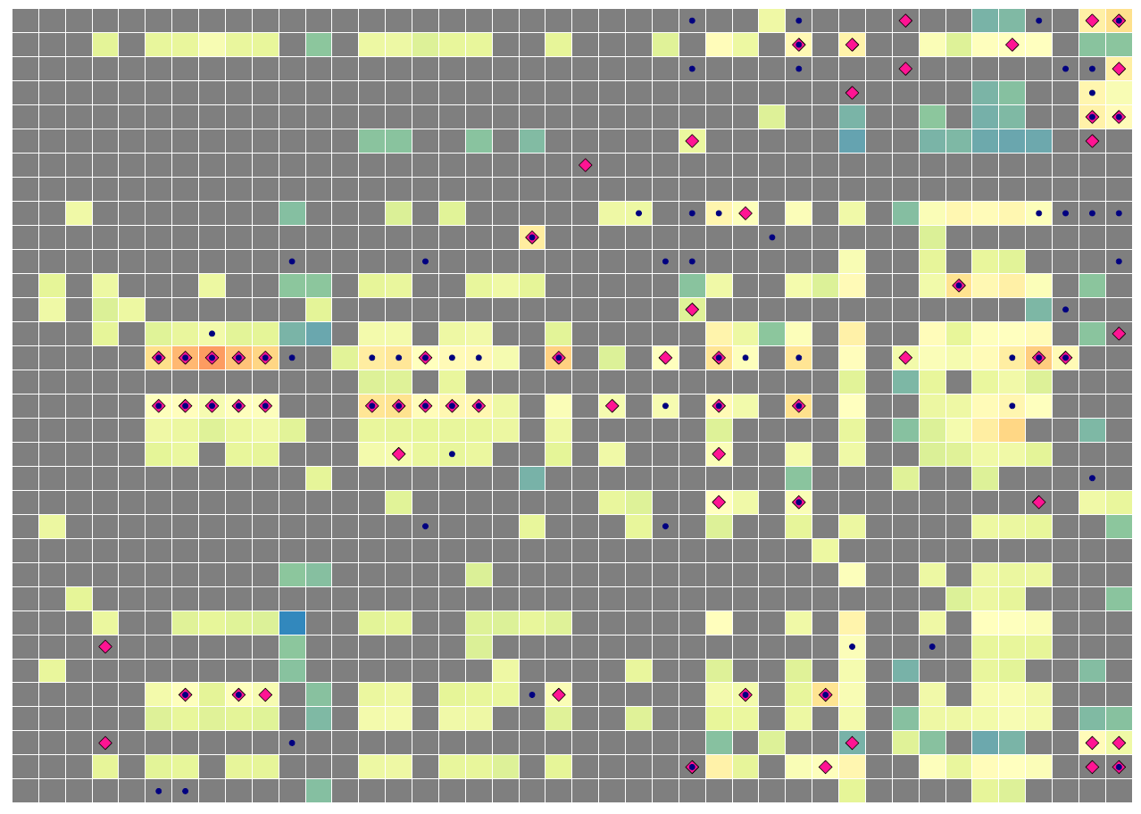
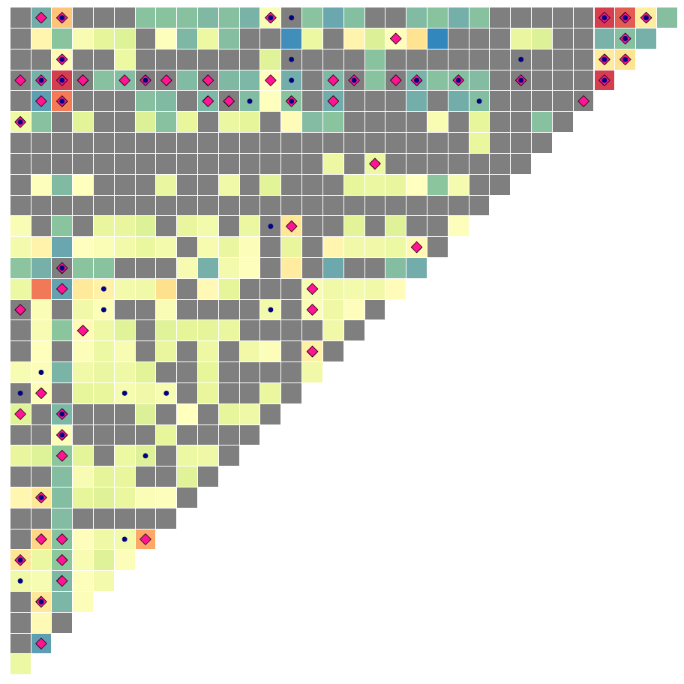
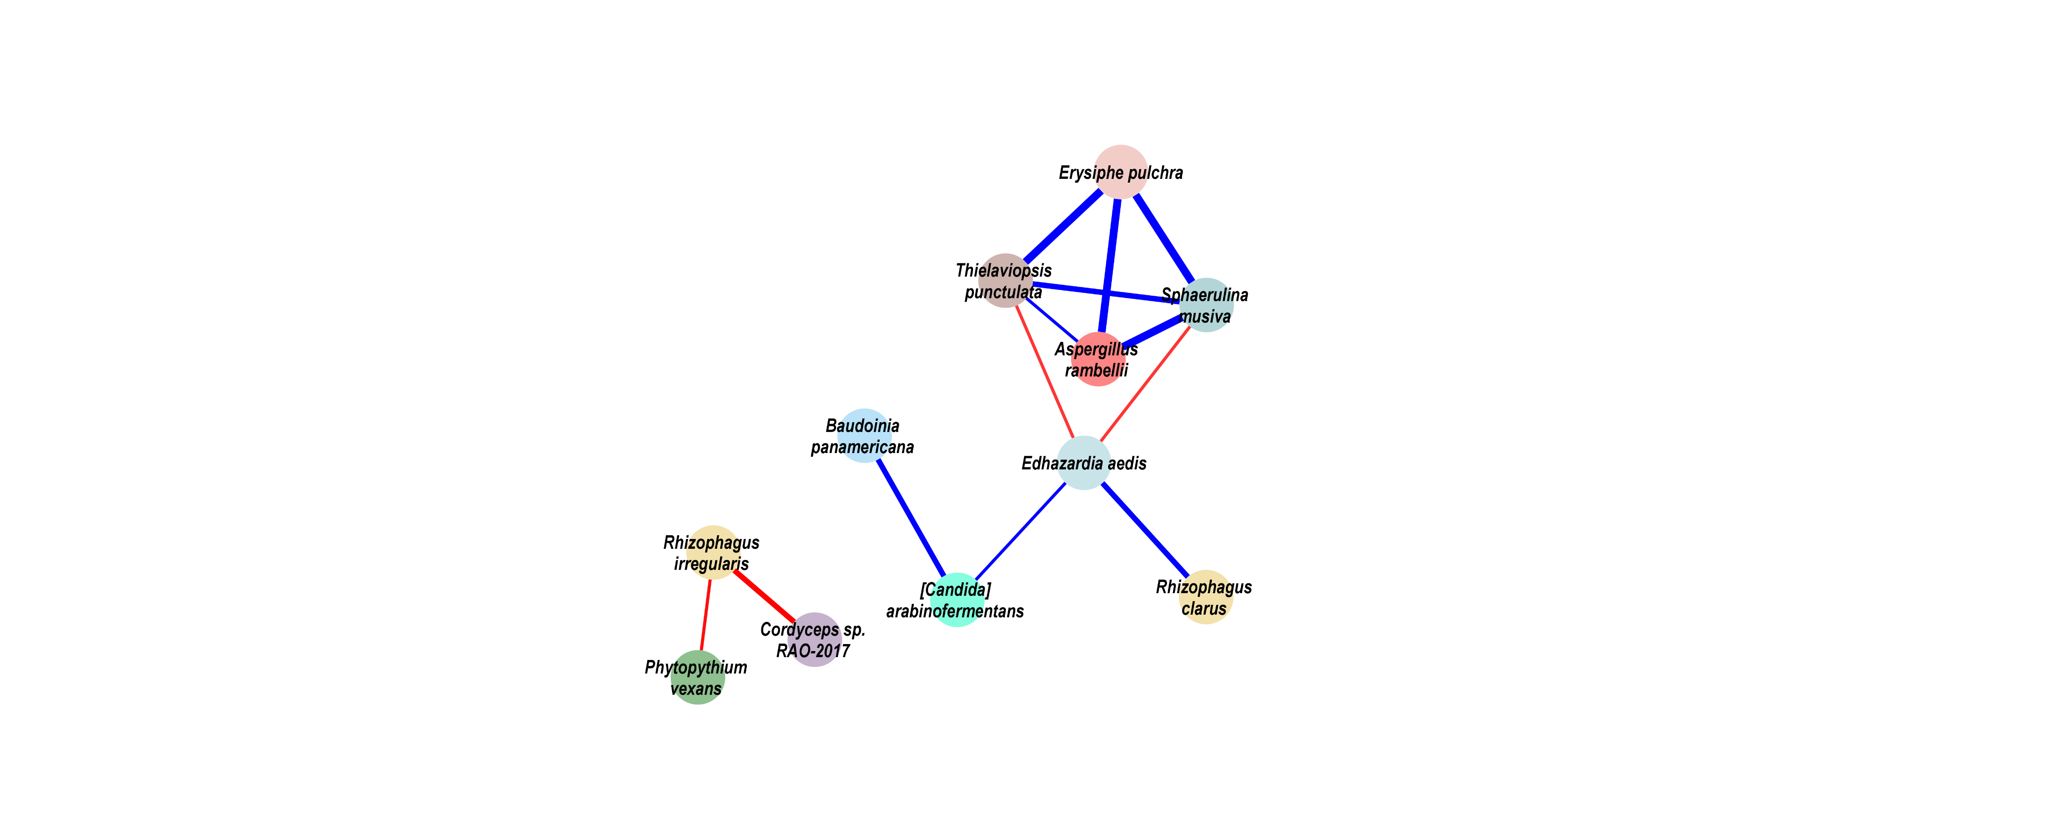
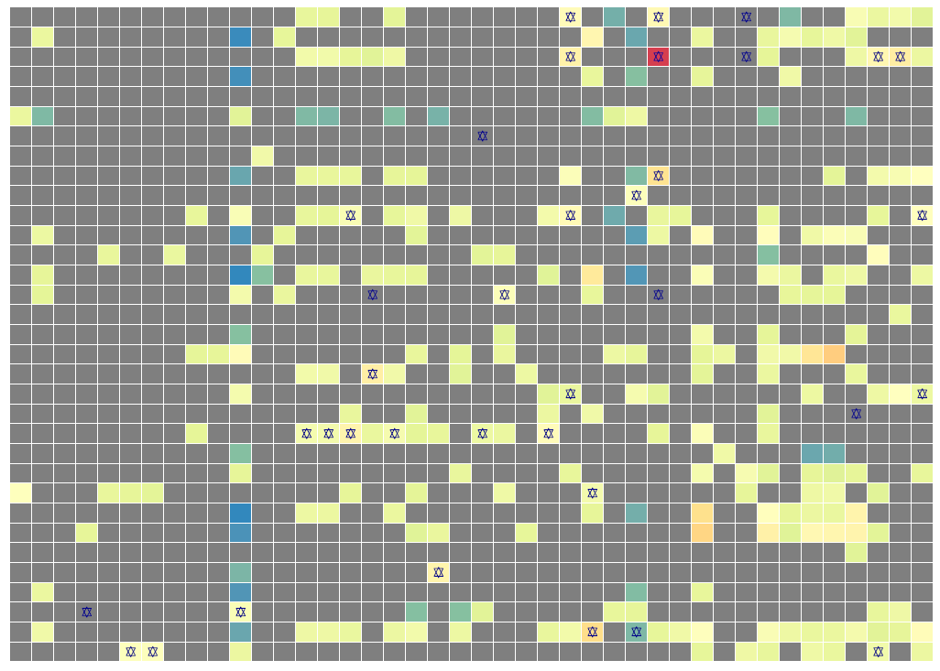
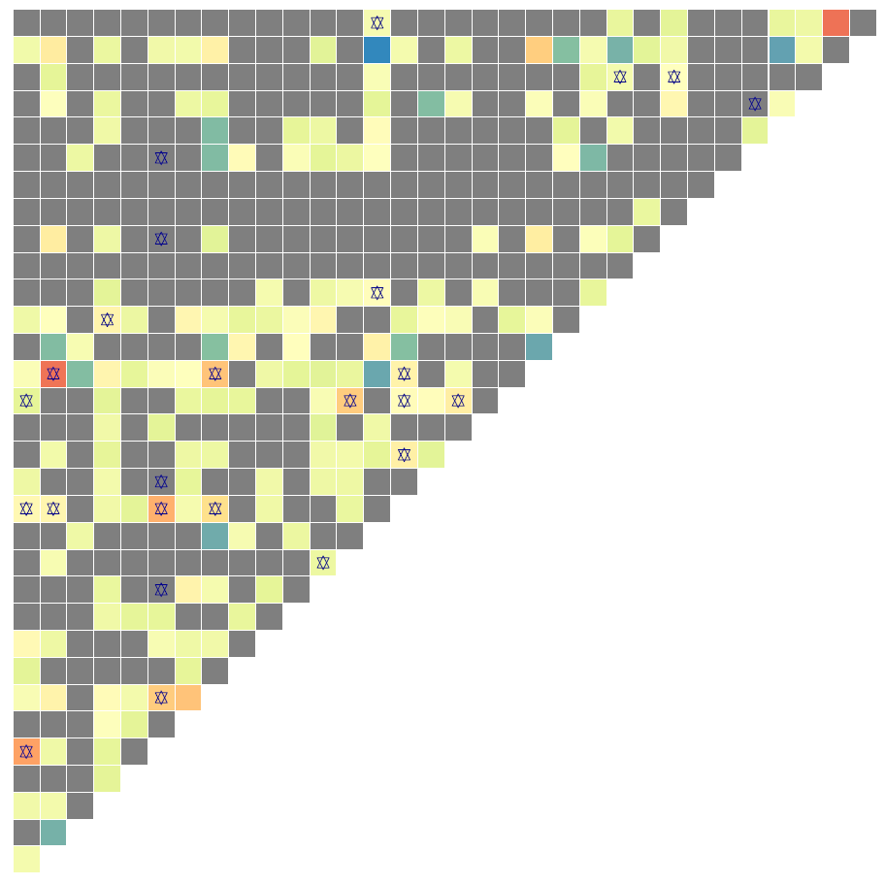
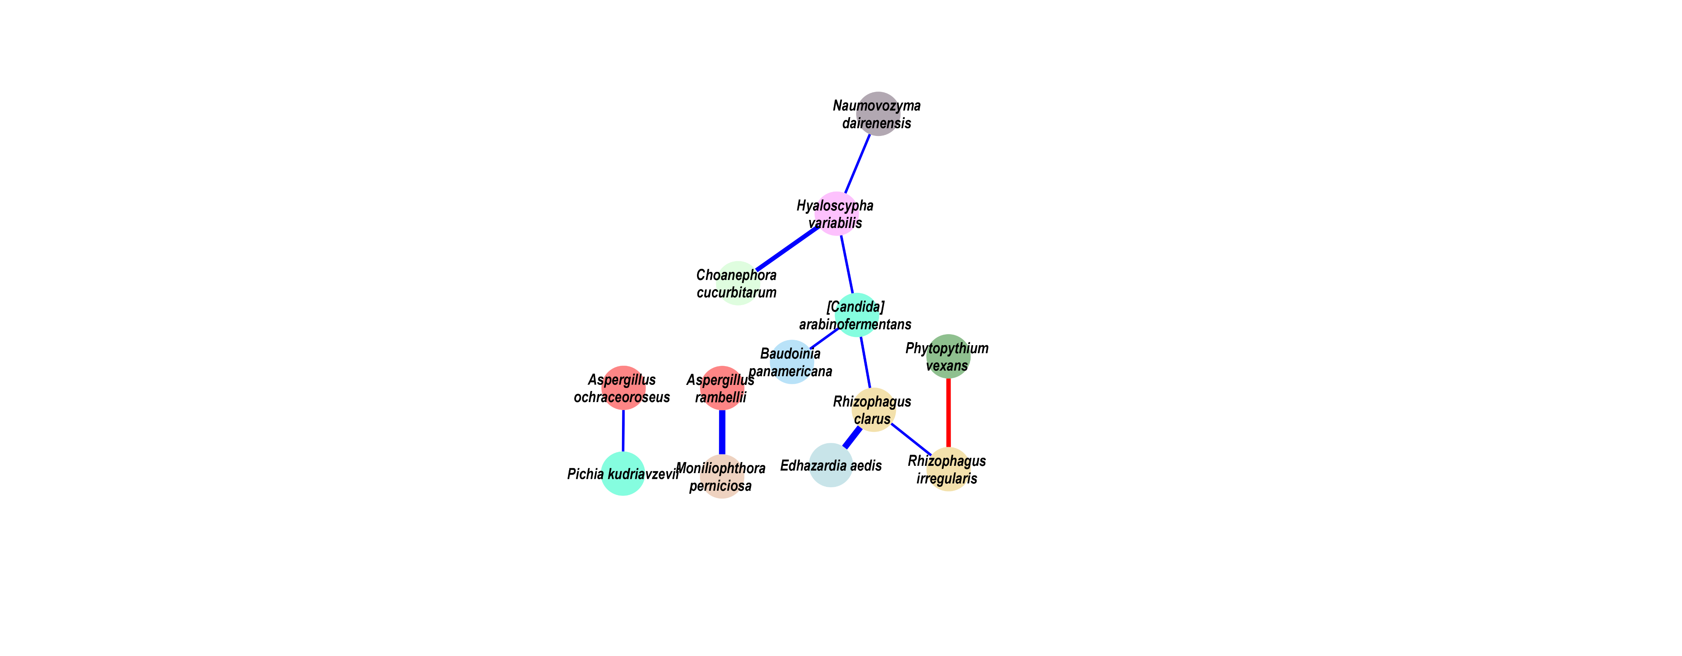
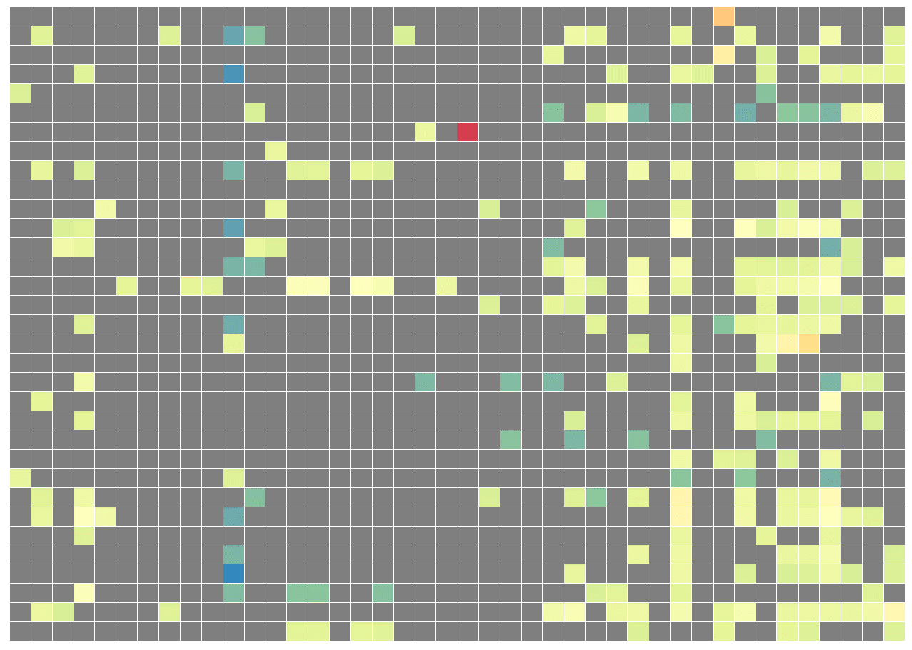
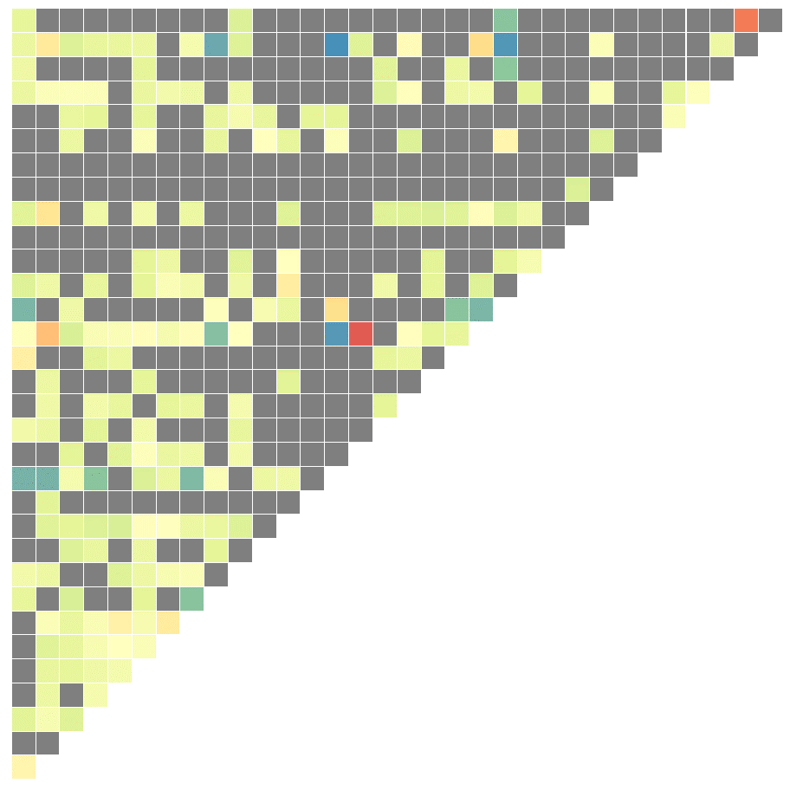
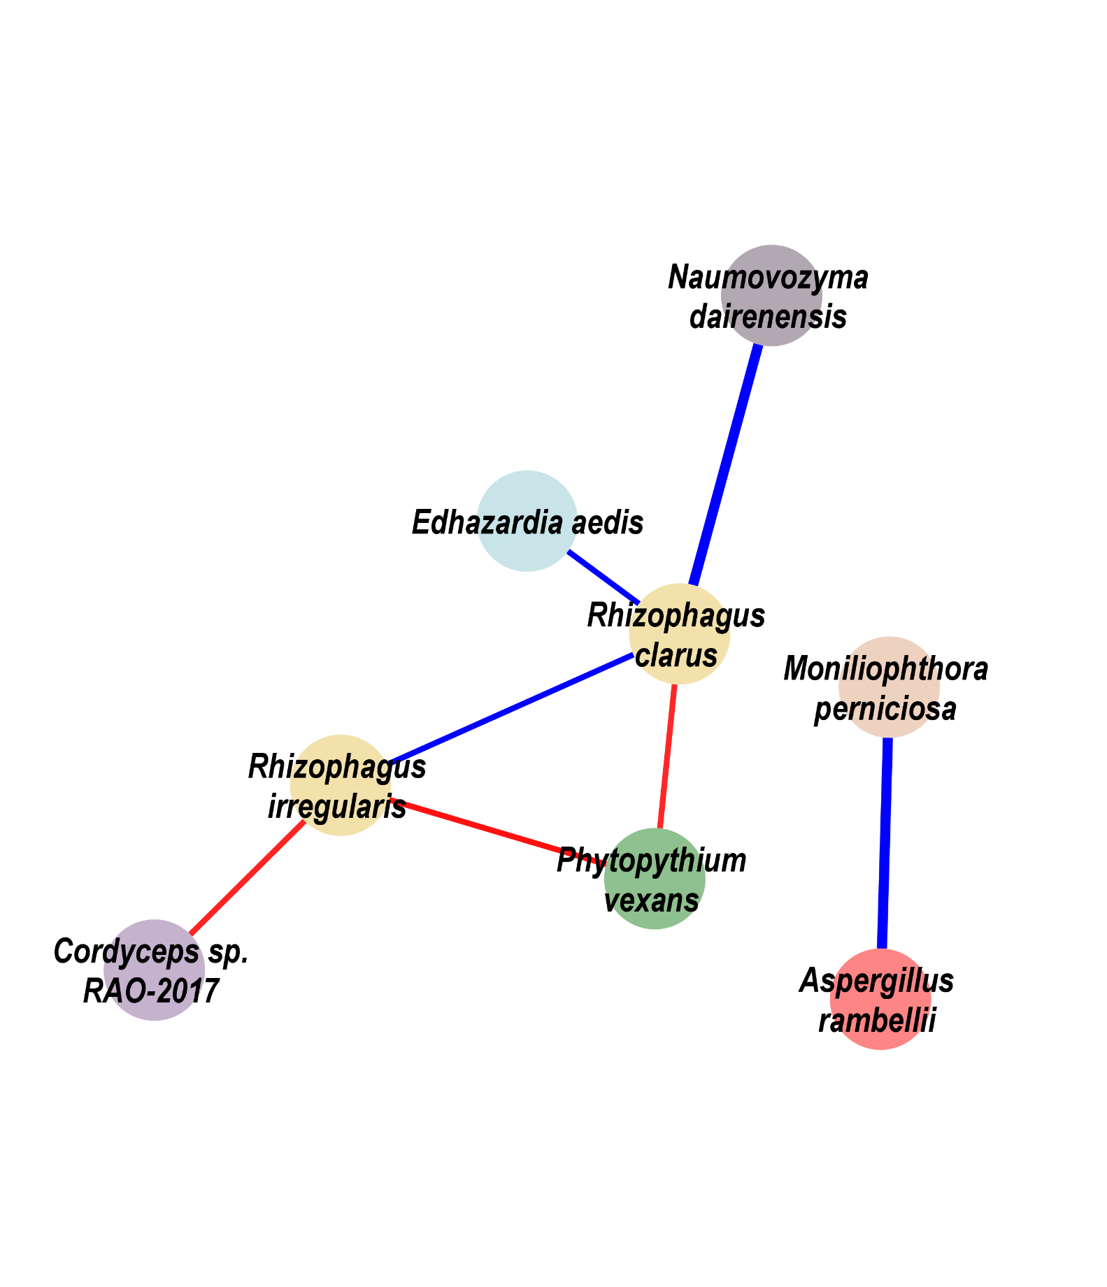

a
Eukaryota Interaction in CRC group
Escherichia coli | Bifidobacterium longum | Ruminococcus bicirculans | Adlercreutzia equolifaciens | Bifidobacterium adolescentis | Streptococcus sp. HSISS2 | Streptococcus sp. HSISS3 | Streptococcus thermophilus | Streptococcus sp. FDAARGOS 192 | Streptococcus sp. HSISS1 | Prevotella intermedia | Alistipes sp. 3BBH6 | Bifidobacterium bifidum | Streptococcus sp. I−G2 | Streptococcus sp. JS71 | Streptococcus milleri | Streptococcus sp. A12 | Streptococcus sp. I−P16 | Streptococcus equinus | Bifidobacterium pseudocatenulatum | Streptococcus salivarius | Bifidobacterium angulatum | Lactobacillus ruminis | Bifidobacterium catenulatum | Streptococcus anginosus | Fusobacterium periodonticum | Clostridium beijerinckii | [Eubacterium] eligens | Porphyromonas asaccharolytica | Romboutsia ilealis | Brachyspira pilosicoli | Blautia sp. SC05B48 | Lactococcus garvieae | Dialister pneumosintes | Longibaculum sp. KGMB06250 | Roseburia intestinalis | Butyrivibrio proteoclasticus | Pseudobutyrivibrio xylanivorans | Anaerostipes hadrus | Gemella morbillorum | Parvimonas micra | Fusobacterium nucleatum
Choanephora cucurbitarum | Edhazardia aedis | Thielaviopsis punctulata | Tuber magnatum | Schizosaccharomyces pombe | Hyaloscypha variabilis | Baudoinia panamericana | [Candida] arabinofermentans | Colletotrichum salicis | Leucoagaricus sp. SymC.cos | Coniochaeta ligniaria | Colletotrichum fioriniae | Aspergillus ochraceoroseus | Phytopythium vexans | Naumovozyma dairenensis | Lipomyces starkeyi | Albugo candida | Paracoccidioides brasiliensis | Pichia kudriavzevii | Rhizophagus clarus | Cordyceps sp. RAO−2017 | Pseudocercospora musae | Trichoderma atroviride | Debaryomyces hansenii | Pneumocystis murina | Aspergillus kawachii | Trichophyton mentagrophytes | Phytophthora capsici | Sphaerulina musiva | Erysiphe pulchra | Moniliophthora perniciosa | Rhizophagus irregularis | Aspergillus rambellii
Aspergillus rambellii
Rhizophagus irregularis
Moniliophthora perniciosa
Erysiphe pulchra
Sphaerulina musiva
Phytophthora capsici
Trichophyton mentagrophytes
Aspergillus kawachii
Pneumocystis murina
Debaryomyces hansenii
Trichoderma atroviride
Pseudocercospora musae
Cordyceps sp. RAO−2017
Rhizophagus clarus
Pichia kudriavzevii
Paracoccidioides brasiliensis
Albugo candida
Lipomyces starkeyi
Naumovozyma dairenensis
Phytopythium vexans
Aspergillus ochraceoroseus
Colletotrichum fioriniae
Coniochaeta ligniaria
Leucoagaricus sp. SymC.cos
Colletotrichum salicis
[Candida] arabinofermentans
Baudoinia panamericana
Hyaloscypha variabilis
Schizosaccharomyces pombe
Tuber magnatum
Thielaviopsis punctulata
Edhazardia aedis
Choanephora cucurbitarum
b
Eukaryota Interaction in adenoma
Aspergillus rambellii
Rhizophagus irregularis
Moniliophthora perniciosa
Erysiphe pulchra
Sphaerulina musiva
Phytophthora capsici
Trichophyton mentagrophytes
Aspergillus kawachii
Pneumocystis murina
Debaryomyces hansenii
Trichoderma atroviride
Pseudocercospora musae
Cordyceps sp. RAO−2017
Rhizophagus clarus
Pichia kudriavzevii
Paracoccidioides brasiliensis
Albugo candida
Lipomyces starkeyi
Naumovozyma dairenensis
Phytopythium vexans
Aspergillus ochraceoroseus
Colletotrichum fioriniae
Coniochaeta ligniaria
Leucoagaricus sp. SymC.cos
Colletotrichum salicis
[Candida] arabinofermentans
Baudoinia panamericana
Hyaloscypha variabilis
Schizosaccharomyces pombe
Tuber magnatum
Thielaviopsis punctulata
Edhazardia aedis
Choanephora cucurbitarum
c
Eukaryota Interaction in Healthy control
Aspergillus rambellii
Rhizophagus irregularis
Moniliophthora perniciosa
Erysiphe pulchra
Sphaerulina musiva
Phytophthora capsici
Trichophyton mentagrophytes
Aspergillus kawachii
Pneumocystis murina
Debaryomyces hansenii
Trichoderma atroviride
Pseudocercospora musae
Cordyceps sp. RAO−2017
Rhizophagus clarus
Pichia kudriavzevii
Paracoccidioides brasiliensis
Albugo candida
Lipomyces starkeyi
Naumovozyma dairenensis
Phytopythium vexans
Aspergillus ochraceoroseus
Colletotrichum fioriniae
Coniochaeta ligniaria
Leucoagaricus sp. SymC.cos
Colletotrichum salicis
[Candida] arabinofermentans
Baudoinia panamericana
Hyaloscypha variabilis
Schizosaccharomyces pombe
Tuber magnatum
Thielaviopsis punctulata
Edhazardia aedis
Choanephora cucurbitarum
0.70
Bacteria
Reported potential
probiotic
Asperillaceae
Ceratocystidaceae
Choanephoraceae
0.50
Reported potential
pathogens
Erysiphaceae
Glomeraceae
Hyaloscyphaceae
0.25
Bacteria
CRC Enriched
Eukaryota
Pichiaceae
Pythiaceae
Saccharomycetaceae
0.00
Eukaryota
Culicosporidae
Mycosphaerallaceae
Cordycipitaceae
-0.20
Eukaryota
CRC Depleted
Eukaryota
Marasmiaceae
Teratosphaeriaceae
Notes:
F:\GitHub\multi-CRC-fungi\08.correlation

Slide 5
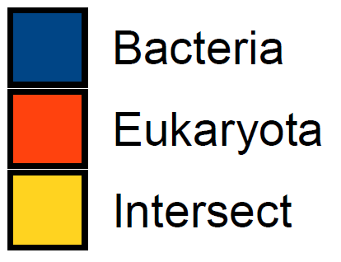

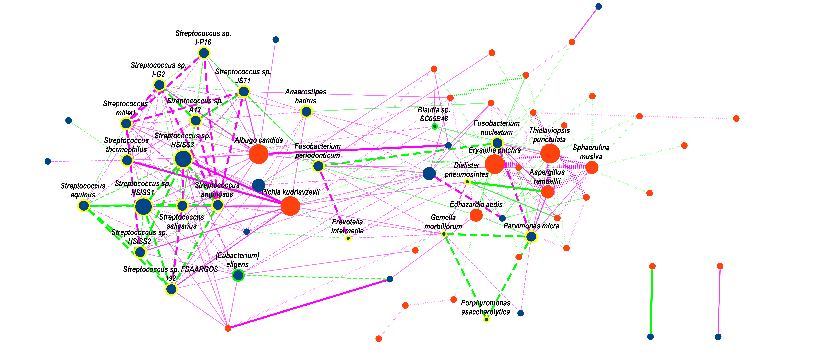



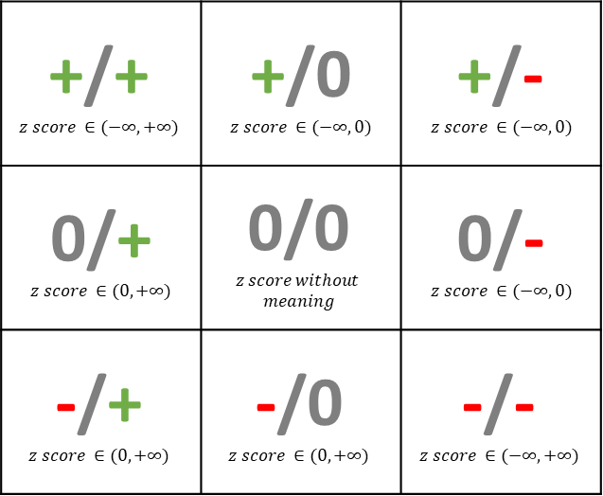
a
Density Plot with z-score in various kingdom features（control vs CRC）
z-score represents the relative strength of differential correlation
0.4
Bac & Bac
0.06
Euk & Euk
0.04
Bac & Euk
0.02
0.3
0.00
-10
0
10
20
30
0.06
0.2
0.04
0.02
0.1
0.00
-10
0
10
20
30
0.3
0.2
0.0
0.1
-10
0
10
20
30
0.0
-10
0
10
20
30
Definition of differential correlation classes
Counts of differential correlation classes with various features
b
c
70
Feature Pair Correlation in CRC
Feature Pair Correlation in control
ρ > 0
p < 0.05
p > 0.05
ρ < 0
p < 0.05
60
ρ > 0
p < 0.05
+/+ $$z score ∈(−∞, +∞)$$ | +/0 $$z score ∈(−∞, 0)$$ | +/- $$z score ∈(−∞, 0)$$
0/+ $$z score ∈(0, +∞)$$ | 0/0 $$z score without$$ $$meaning$$ | 0/- $$z score ∈(−∞, 0)$$
-/+ $$z score ∈(0, +∞)$$ | -/0 $$z score ∈(0, +∞)$$ | -/- $$z score ∈(−∞, +∞)$$
41
p < 0.05
40
28
20
10
9
18
12
18
12
ρ < 0
p < 0.05
0
0
1
1
0
6
1
0
6
0
+/+
+/0
0/+
0/-
-/+
-/0
d
Network for the differential correlation in control and CRC comparison
Reported potential
pathogens
z-score < 0 [Corr_{CRC} > Corr_{Ctrl} ]
Reported potential
probiotic
z-score > 0 [Corr_{CRC} < Corr_{Ctrl} ]
Unreported bacteria
External Correlation
Bacterial Correlation
Eukaryota
Eukaryotic Correlation
Counts_{corr} ≤ 8
Abs(z-score) ≤ 5
8 < Counts_{corr} ≤ 14
5 ≤ Abs(z-score) < 6
14 < Counts_{corr}
6 ≤ Abs(z-score)

Slide 6
Future Goals
For this project
Feature further analysis
Aspergillus rambellii
Aspergillus kawachii
Cell line co-culture
Animal experiment validation
AEEC (Animal Experimentation Ethics Committee) applying
Animal License applying
APC^{min+} model validation
Another project
Lixia’s Multifocal-HCC project

Slide 7
Low-abundance
Group
High-abundance
Group

Slide 9
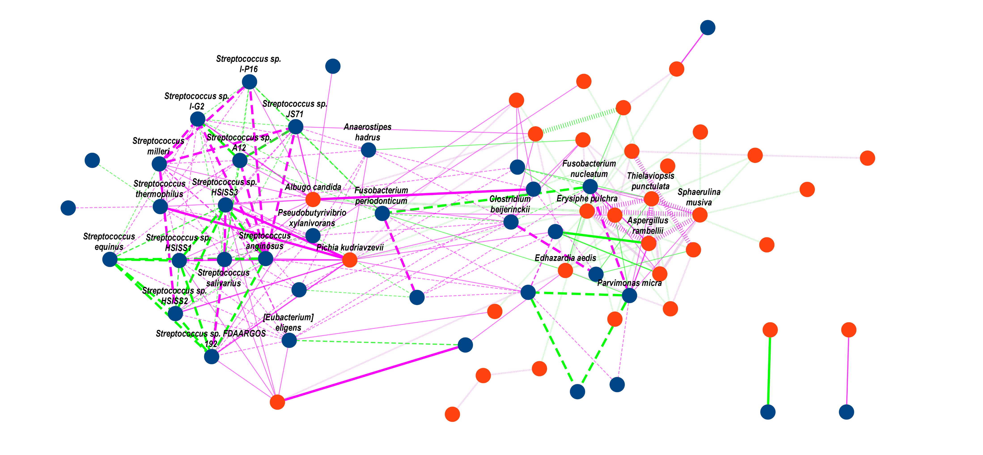
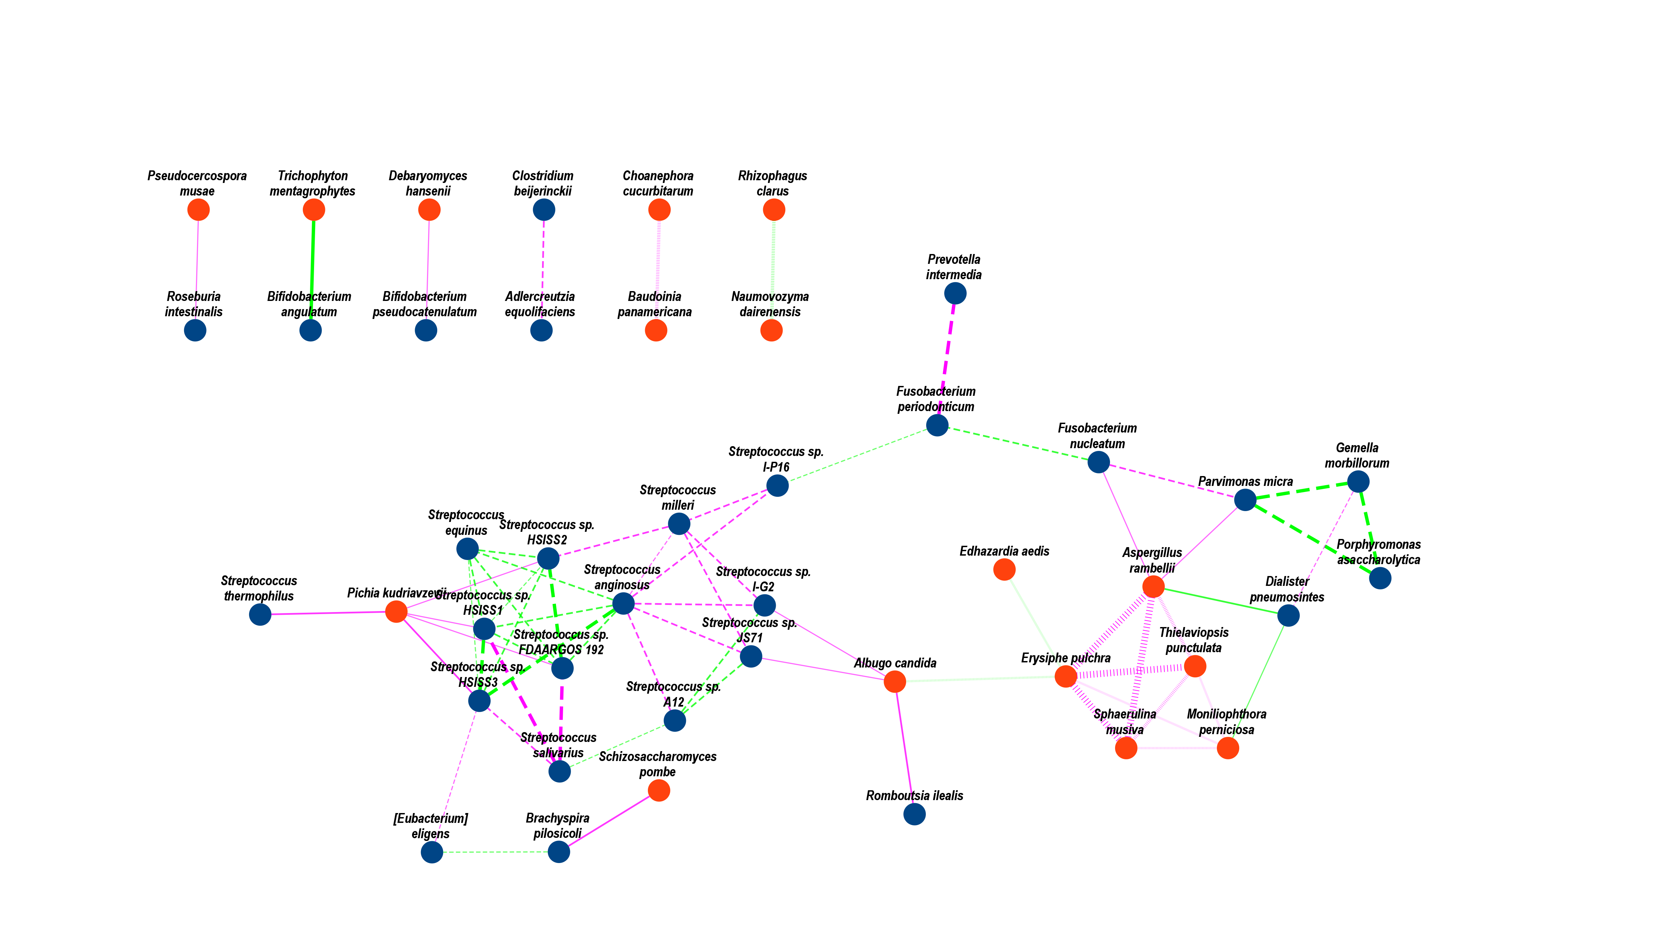

Slide 10
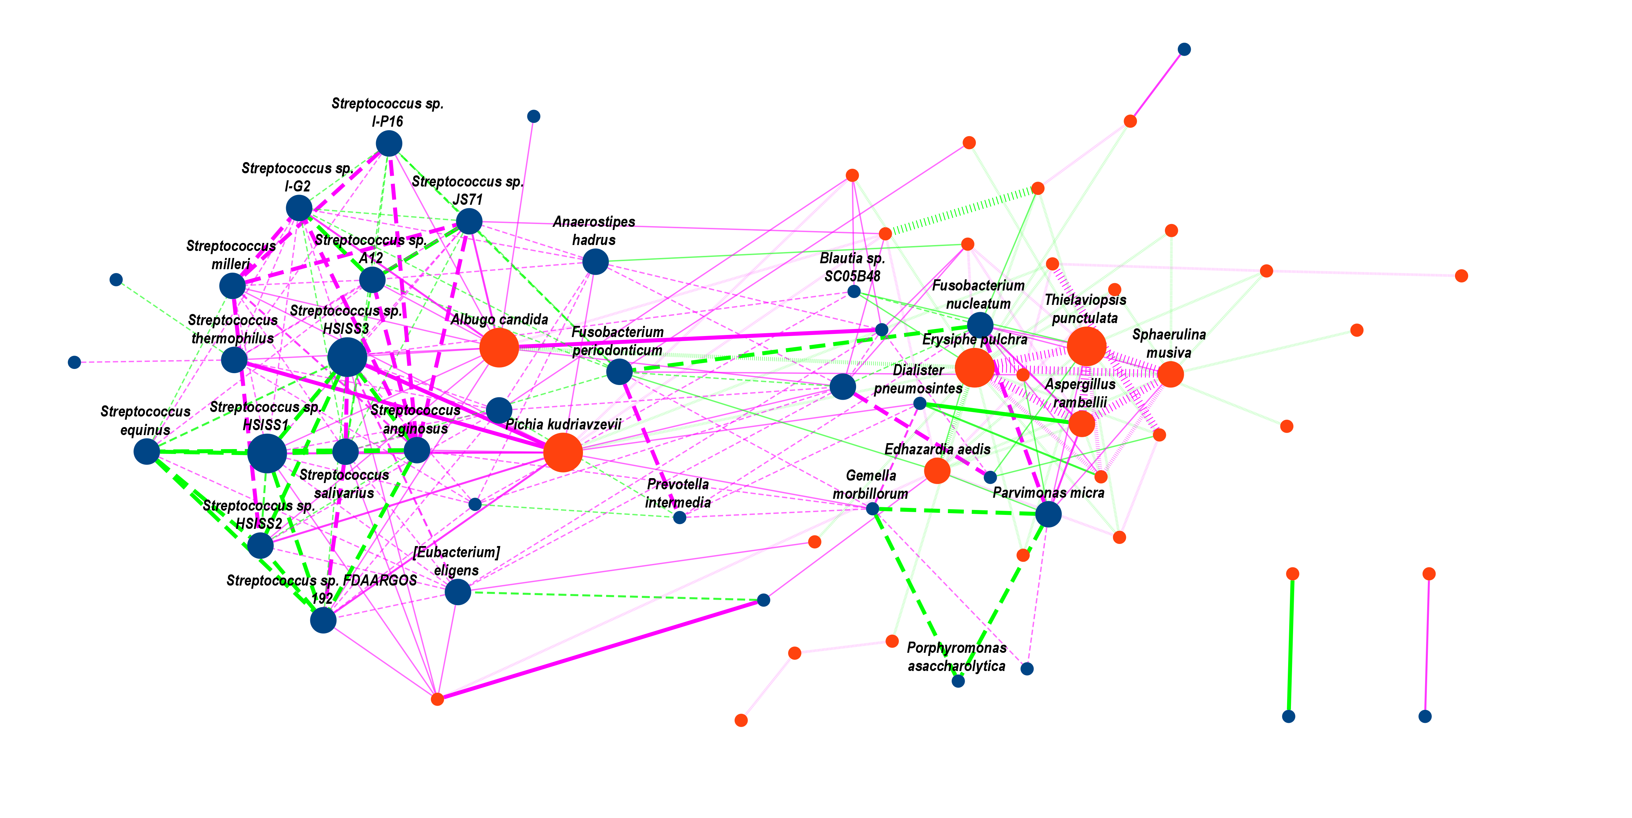

Slide 11
Import OTU matrix
analysis by the kraken2 & bracken
1
2
3
Fungi alpha diversity
Meta-analysis significant fungi
Correlation distribution
1. Each cohorts performance [violin plot]
1. General significant difference [bar plot]
1. Fungi internal correlations [strangle hm]
2. Line regression with bac alpha diversity [point plot]
2. Selected in each cohort relative abundance [hm]
2. Fungi & bacteria relationships [hm + bar plot]
3. Clinical subgroup (AJCC, gender, BMI) [bar plot]
3. Selected in each cohort fold change [boxplot]
Fungi beta diversity
4
1. PCOA
Individual fungi
2. t-SNE/ CCA/ RDA
1. Correlation with clinical info
3. PCA contribution
[stages/ cohorts/ clinical info]
2. Functional analysis
Fungi composition
2. Meta-analysis significant fungi
把阈值放宽，挑选出所有有相同trend (≥ 7)的features， 画分布直方图，分方向。[绘制柱状图，加个横线分开]
根据Wilcoxon rank test再去筛选 p value 。[cohort的热图，p-value + CTRL + CRC]
最后卡一个|log₂FC| ≥ 0.5的阈值，筛选得到最终的结果。[小提琴图]
1. Phylum
2. Species
1. Fungi profiles:
Alpha 多样性，
绘制小提琴图，根据不同的stages分组，可以包含所有的features， 也可以去掉一些0过多的features。
Alpha 多样性，把每个cohort的情况以点图 + Quarter 的形式添加到小提琴中。
画一个回归，看看fungi和bac的alpha diversity的相关性情况，是否共增或者共减。
通过AJCC/ 性别分组，去绘制alpha 多样性图，也可以画和BMI的相关性。
Beta 多样性
非监督聚类，PCoA
监督性聚类， t-SNE/ CCA/ RDA
根据stages/ cohorts/ 或者其他clinic的信息去看看他们在每个PCoA中的贡献是怎么样的 [参考cell那篇文章]。
真菌的组成
从不同的level去看（phylum和species），画堆积直方图，对数据进行拟合（参考Wilson和长安他们文章）
真菌的比例在不同的samples、stages中的分布，画直方图，也可以做一个线性拟合。

Slide 13

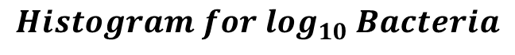
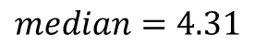
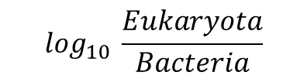
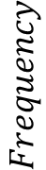
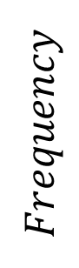
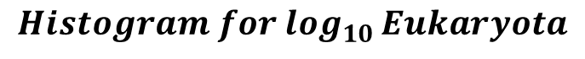
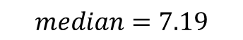
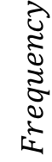
$$Histogram for \log_{10} \frac{Eukaryota}{Bacteria}$$
200
$$Histogram for \log_{10 }Eukaryota$$
$$median=−2.80$$
200
$$median=4.31$$
$$Frequency$$
150
150
100
$$Frequency$$
50
0
1
2
3
4
5
6
100
150
$$Histogram for \log_{10} Bacteria$$
100
$$median=7.19$$
50
$$Frequency$$
50
0
4
5
6
7
8
0
−6
−5
−4
−3
−2
−1
0
$$\log_{10} \frac{Eukaryota}{Bacteria}$$
Sequence quality control
2,052 samples
filter history
surgery patients
1,986 samples
filter none
stage patients
1,919 samples
filter the low-alignment-reads sample (< 1M )
1,901 samples
Outlier samples filtering
1,636 samples
filter suspected of fungal contamination
(1 species> 50%)
1,731 samples
filter suspected of bacteria contamination
(1 species> 50%)
1,802 samples
filter the
high-Eukaryota
sample (> 1% )
1,882 samples
filter the
low-Eukaryota
sample (< 0.01% )
Downstream analysis
Items | adenoma | CRC | CTRL | filter | leave
import samples | - | - | - | - | 1,919
filter low-align-reads samples | 10 | 1 | 7 | 18 | 1,901
filter low-Eukaryota samples | 14 | 36 | 30 | 80 | 1,882
filter high-Eukaryota samples | 5 | 8 | 6 | 19 | 1,802
filter suspected bacteria contamination samples | 19 | 20 | 32 | 71 | 1,731
filter suspected fungal contamination samples | 22 | 36 | 37 | 95 | 1,636
filter low sample counts cohort | 1 | 6 | 4 | 11 | 1,625
low samples counts leave cohort
1,625 samples

Slide 14
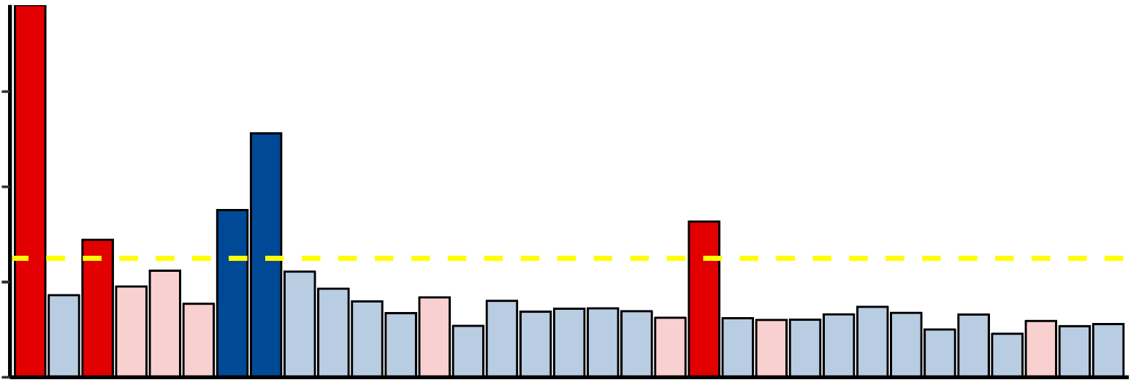
17.0
17.0
7.5
7.5
- log₁₀ FDR
5.0
- log₁₀ FDR
5.0
2.5
FDR < 0.1
0.0
2.5
FDR < 0.01
0.0
Aspergillus rambellii
Rhizophagus irregularis
Moniliophthora perniciosa
Erysiphe pulchra
Sphaerulina musiva
Phytophthora capsici
Trichophyton mentagrophytes
Aspergillus kawachii
Pneumocystis murina
Debaryomyces hansenii
Trichoderma atroviride
Pseudocercospora musae
Cordyceps sp. RAO−2017
Rhizophagus clarus
Pichia kudriavzevii
Paracoccidioides brasiliensis
Albugo candida
Lipomyces starkeyi
Naumovozyma dairenensis
Phytopythium vexans
Aspergillus ochraceoroseus
Colletotrichum fioriniae
Coniochaeta ligniaria
Leucoagaricus sp. SymC.cos
Colletotrichum salicis
[Candida] arabinofermentans
Baudoinia panamericana
Hyaloscypha variabilis
Schizosaccharomyces pombe
Tuber magnatum
Thielaviopsis punctulata
Edhazardia aedis
Choanephora cucurbitarum
Elsinoe australis
Piromyces sp. E2
Mucor circinelloides
Amorphotheca resinae
Colletotrichum tofieldiae
Sporisorium reilianum
Periconia macrospinosa
Blastomyces gilchristii
Cyberlindnera fabianii
Rhizoctonia solani
Spizellomyces punctatus
Pseudocercospora eumusae
Blumeria graminis
Pseudocercospora fijiensis
Aureobasidium namibiae
Calocera cornea
Polytolypa hystricis
Rhizopus delemar
Pythium aphanidermatum
Rozella allomycis
Batrachochytrium salamandrivorans
Rhizoclosmatium globosum
Cercospora zeina
Aspergillus steynii
Pezoloma ericae
Cordyceps fumosorosea
Pneumocystis carinii
Phialocephala subalpina
Moniliophthora roreri
Hanseniaspora valbyensis
Syncephalastrum racemosum
Histoplasma capsulatum
Tuber borchii
Phycomyces blakesleeanus
Saitoella complicata
Saccharomyces cerevisiae
Aspergillus udagawae
Candida maltosa
Rhodotorula graminis
Rutstroemia sp. NJR−2017a WRK4
Tolypocladium paradoxum
2014_ZellerG
(EU)
2015_FengQ
(OC)
2016_VogtmannE
(NA)
2019_Thom
(EU)
2019_WirbelJ
(EU)
2019_Yachida
(AS)
2021_JunY_1
(AS)
2021_JunY_2
(AS)
abs( log₂ FC )
Aspergillus rambellii
- log₁₀(p value)
1.2
Moniliophthora perniciosa
Trichophyton mentagrophytes
abs( log₂ FC ) > 0.5
log₂(Fold change)
0.8
Aspergillus kawachii
Aspergillus ochraceoroseus
0.4
0.0
CRC Enriched
CRC Depleted
Notes:
F:\GitHub\multi-CRC-fungi\07.FeatureSelection\03.Plot

Slide 15

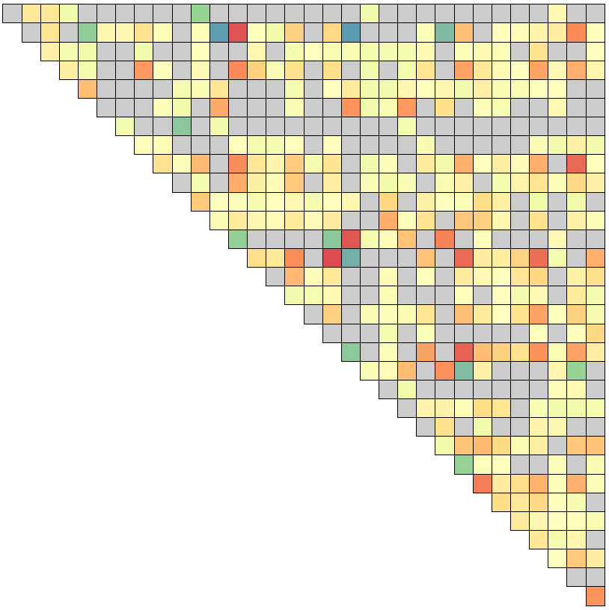
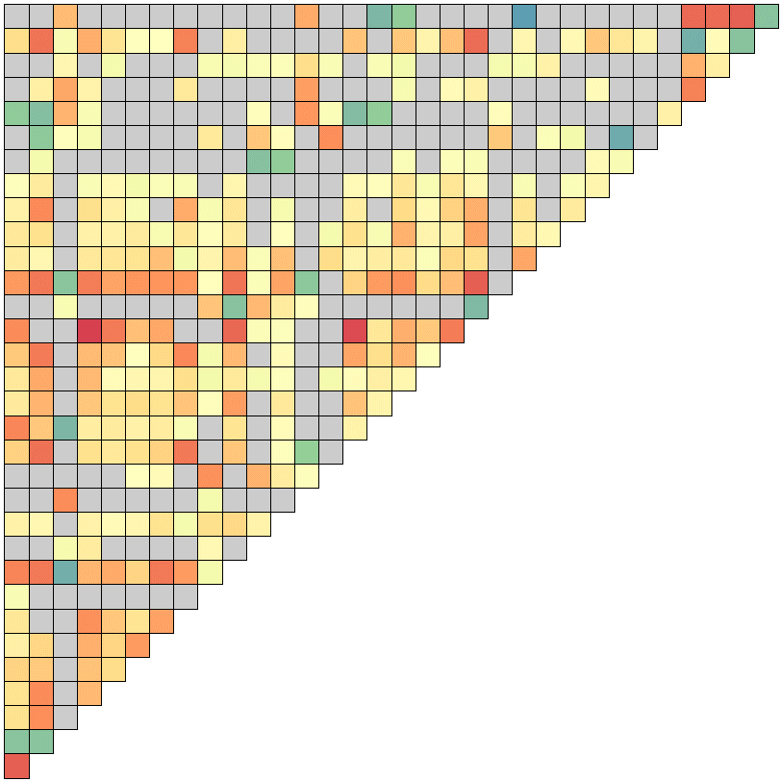
-0.2
0
0.2
0.4
Aspergillus rambellii
Rhizophagus irregularis
Moniliophthora perniciosa
Erysiphe pulchra
Sphaerulina musiva
Phytophthora capsici
Trichophyton mentagrophytes
Aspergillus kawachii
Pneumocystis murina
Debaryomyces hansenii
Trichoderma atroviride
Pseudocercospora musae
Cordyceps sp. RAO−2017
Rhizophagus clarus
Pichia kudriavzevii
Paracoccidioides brasiliensis
Albugo candida
Lipomyces starkeyi
Naumovozyma dairenensis
Phytopythium vexans
Aspergillus ochraceoroseus
Colletotrichum fioriniae
Coniochaeta ligniaria
Leucoagaricus sp. SymC.cos
Colletotrichum salicis
[Candida] arabinofermentans
Baudoinia panamericana
Hyaloscypha variabilis
Schizosaccharomyces pombe
Tuber magnatum
Thielaviopsis punctulata
Edhazardia aedis

Slide 16
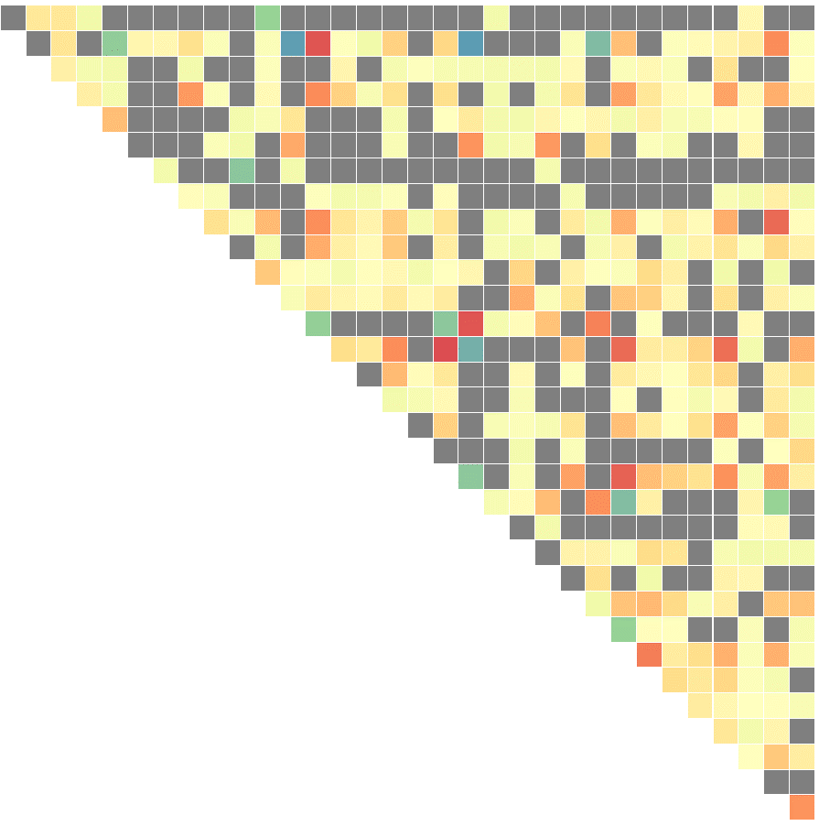
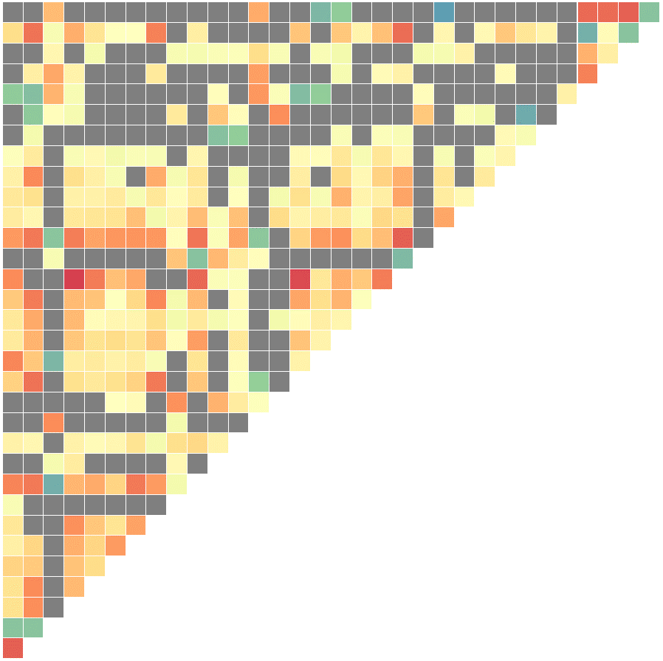
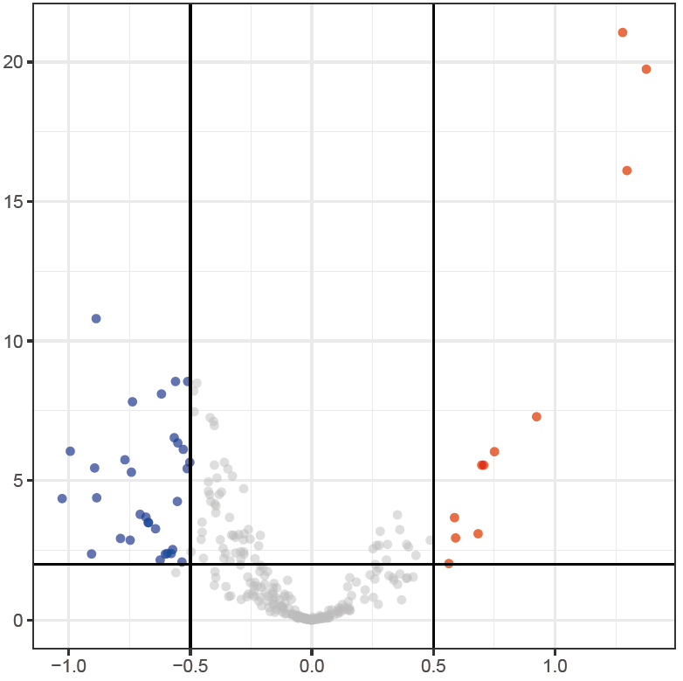
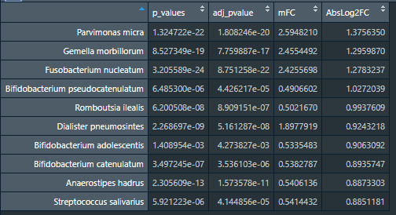
Eukaryota Interaction in Healthy control
-0.2
0
0.2
0.4
Eukaryota Interaction in CRC group
Aspergillus rambellii
Rhizophagus irregularis
Moniliophthora perniciosa
Erysiphe pulchra
Sphaerulina musiva
Phytophthora capsici
Trichophyton mentagrophytes
Aspergillus kawachii
Pneumocystis murina
Debaryomyces hansenii
Trichoderma atroviride
Pseudocercospora musae
Cordyceps sp. RAO−2017
Rhizophagus clarus
Pichia kudriavzevii
Paracoccidioides brasiliensis
Albugo candida
Lipomyces starkeyi
Naumovozyma dairenensis
Phytopythium vexans
Aspergillus ochraceoroseus
Colletotrichum fioriniae
Coniochaeta ligniaria
Leucoagaricus sp. SymC.cos
Colletotrichum salicis
[Candida] arabinofermentans
Baudoinia panamericana
Hyaloscypha variabilis
Schizosaccharomyces pombe
Tuber magnatum
Thielaviopsis punctulata
Edhazardia aedis
-log10(Q-value)
Log2(Fold change)
Notes:
F:\GitHub\multi-CRC-fungi\08.correlation

Slide 17
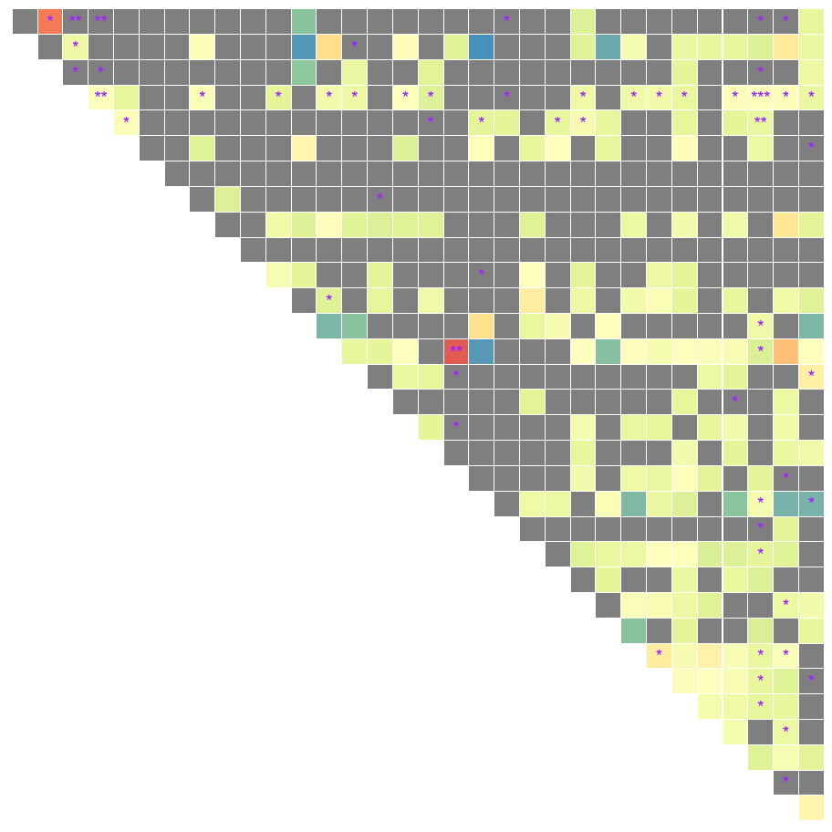
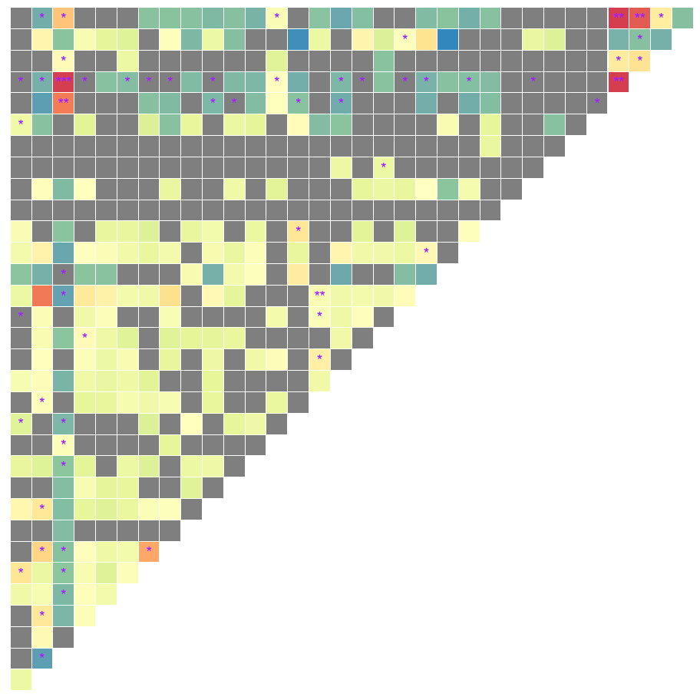
Eukaryota Interaction in Healthy control
0.00
0.25
0.50
Eukaryota Interaction in CRC group
Rhizophagus irregularis | Moniliophthora perniciosa | Erysiphe pulchra | Sphaerulina musiva | Phytophthora capsici | Trichophyton mentagrophytes | Aspergillus kawachii | Pneumocystis murina | Debaryomyces hansenii | Trichoderma atroviride | Pseudocercospora musae | Cordyceps sp. RAO−2017 | Rhizophagus clarus | Pichia kudriavzevii | Paracoccidioides brasiliensis | Albugo candida | Lipomyces starkeyi | Naumovozyma dairenensis | Phytopythium vexans | Aspergillus ochraceoroseus | Colletotrichum fioriniae | Coniochaeta ligniaria | Leucoagaricus sp. SymC.cos | Colletotrichum salicis | [Candida] arabinofermentans | Baudoinia panamericana | Hyaloscypha variabilis | Schizosaccharomyces pombe | Tuber magnatum | Thielaviopsis punctulata | Edhazardia aedis
Choanephora cucurbitarum | Edhazardia aedis | Thielaviopsis punctulata | Tuber magnatum | Schizosaccharomyces pombe | Hyaloscypha variabilis | Baudoinia panamericana | [Candida] arabinofermentans | Colletotrichum salicis | Leucoagaricus sp. SymC.cos | Coniochaeta ligniaria | Colletotrichum fioriniae | Aspergillus ochraceoroseus | Phytopythium vexans | Naumovozyma dairenensis | Lipomyces starkeyi | Albugo candida | Paracoccidioides brasiliensis | Pichia kudriavzevii | Rhizophagus clarus | Cordyceps sp. RAO−2017 | Pseudocercospora musae | Trichoderma atroviride | Debaryomyces hansenii | Pneumocystis murina | Aspergillus kawachii | Trichophyton mentagrophytes | Phytophthora capsici | Sphaerulina musiva | Erysiphe pulchra | Moniliophthora perniciosa | Rhizophagus irregularis
Aspergillus rambellii
Rhizophagus irregularis
Moniliophthora perniciosa
Erysiphe pulchra
Sphaerulina musiva
Phytophthora capsici
Trichophyton mentagrophytes
Aspergillus kawachii
Pneumocystis murina
Debaryomyces hansenii
Trichoderma atroviride
Pseudocercospora musae
Cordyceps sp. RAO−2017
Rhizophagus clarus
Pichia kudriavzevii
Paracoccidioides brasiliensis
Albugo candida
Lipomyces starkeyi
Naumovozyma dairenensis
Phytopythium vexans
Aspergillus ochraceoroseus
Colletotrichum fioriniae
Coniochaeta ligniaria
Leucoagaricus sp. SymC.cos
Colletotrichum salicis
[Candida] arabinofermentans
Baudoinia panamericana
Hyaloscypha variabilis
Schizosaccharomyces pombe
Tuber magnatum
Thielaviopsis punctulata
Edhazardia aedis
-log10(Q-value)
Log2(Fold change)
Notes:
F:\GitHub\multi-CRC-fungi\08.correlation

Slide 18
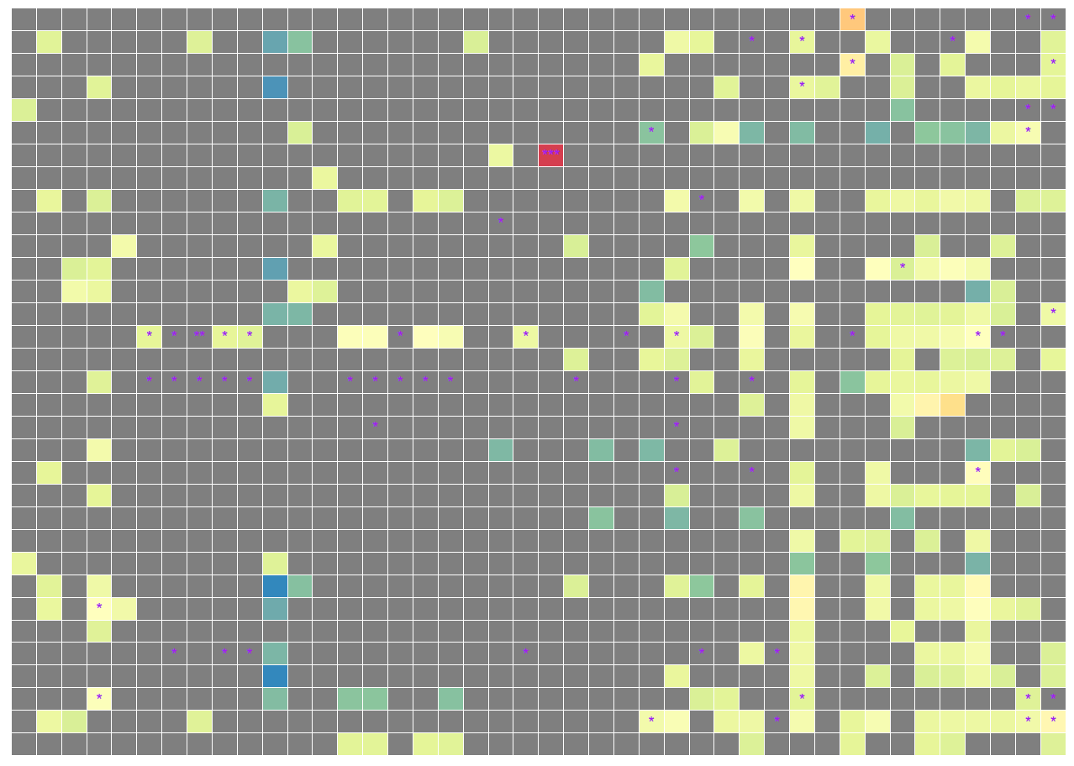

Eukaryota Interaction in CRC group
0.00
0.25
0.50
Escherichia coli | Bifidobacterium longum | Ruminococcus bicirculans | Adlercreutzia equolifaciens | Bifidobacterium adolescentis | Streptococcus sp. HSISS2 | Streptococcus sp. HSISS3 | Streptococcus thermophilus | Streptococcus sp. FDAARGOS 192 | Streptococcus sp. HSISS1 | Prevotella intermedia | Alistipes sp. 3BBH6 | Bifidobacterium bifidum | Streptococcus sp. I−G2 | Streptococcus sp. JS71 | Streptococcus milleri | Streptococcus sp. A12 | Streptococcus sp. I−P16 | Streptococcus equinus | Bifidobacterium pseudocatenulatum | Streptococcus salivarius | Bifidobacterium angulatum | Lactobacillus ruminis | Bifidobacterium catenulatum | Streptococcus anginosus | Fusobacterium periodonticum | Clostridium beijerinckii | [Eubacterium] eligens | Porphyromonas asaccharolytica | Romboutsia ilealis | Brachyspira pilosicoli | Blautia sp. SC05B48 | Lactococcus garvieae | Dialister pneumosintes | Longibaculum sp. KGMB06250 | Roseburia intestinalis | Butyrivibrio proteoclasticus | Pseudobutyrivibrio xylanivorans | Anaerostipes hadrus | Gemella morbillorum | Parvimonas micra | Fusobacterium nucleatum
Choanephora cucurbitarum | Edhazardia aedis | Thielaviopsis punctulata | Tuber magnatum | Schizosaccharomyces pombe | Hyaloscypha variabilis | Baudoinia panamericana | [Candida] arabinofermentans | Colletotrichum salicis | Leucoagaricus sp. SymC.cos | Coniochaeta ligniaria | Colletotrichum fioriniae | Aspergillus ochraceoroseus | Phytopythium vexans | Naumovozyma dairenensis | Lipomyces starkeyi | Albugo candida | Paracoccidioides brasiliensis | Pichia kudriavzevii | Rhizophagus clarus | Cordyceps sp. RAO−2017 | Pseudocercospora musae | Trichoderma atroviride | Debaryomyces hansenii | Pneumocystis murina | Aspergillus kawachii | Trichophyton mentagrophytes | Phytophthora capsici | Sphaerulina musiva | Erysiphe pulchra | Moniliophthora perniciosa | Rhizophagus irregularis
Aspergillus rambellii
Rhizophagus irregularis
Moniliophthora perniciosa
Erysiphe pulchra
Sphaerulina musiva
Phytophthora capsici
Trichophyton mentagrophytes
Aspergillus kawachii
Pneumocystis murina
Debaryomyces hansenii
Trichoderma atroviride
Pseudocercospora musae
Cordyceps sp. RAO−2017
Rhizophagus clarus
Pichia kudriavzevii
Paracoccidioides brasiliensis
Albugo candida
Lipomyces starkeyi
Naumovozyma dairenensis
Phytopythium vexans
Aspergillus ochraceoroseus
Colletotrichum fioriniae
Coniochaeta ligniaria
Leucoagaricus sp. SymC.cos
Colletotrichum salicis
[Candida] arabinofermentans
Baudoinia panamericana
Hyaloscypha variabilis
Schizosaccharomyces pombe
Tuber magnatum
Thielaviopsis punctulata
Edhazardia aedis
Choanephora cucurbitarum
Eukaryota Interaction in Healthy control
Aspergillus rambellii
Rhizophagus irregularis
Moniliophthora perniciosa
Erysiphe pulchra
Sphaerulina musiva
Phytophthora capsici
Trichophyton mentagrophytes
Aspergillus kawachii
Pneumocystis murina
Debaryomyces hansenii
Trichoderma atroviride
Pseudocercospora musae
Cordyceps sp. RAO−2017
Rhizophagus clarus
Pichia kudriavzevii
Paracoccidioides brasiliensis
Albugo candida
Lipomyces starkeyi
Naumovozyma dairenensis
Phytopythium vexans
Aspergillus ochraceoroseus
Colletotrichum fioriniae
Coniochaeta ligniaria
Leucoagaricus sp. SymC.cos
Colletotrichum salicis
[Candida] arabinofermentans
Baudoinia panamericana
Hyaloscypha variabilis
Schizosaccharomyces pombe
Tuber magnatum
Thielaviopsis punctulata
Edhazardia aedis
Choanephora cucurbitarum
-log10(Q-value)
Log2(Fold change)
Notes:
F:\GitHub\multi-CRC-fungi\08.correlation

Slide 19

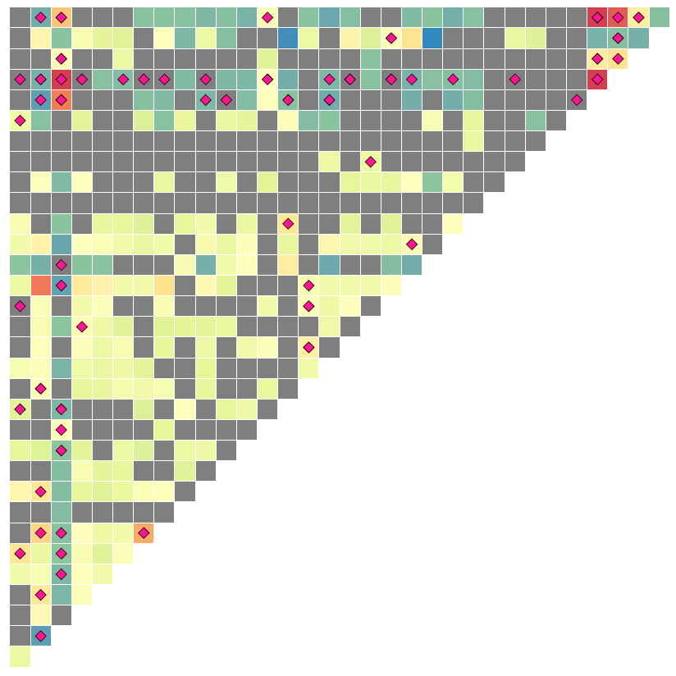
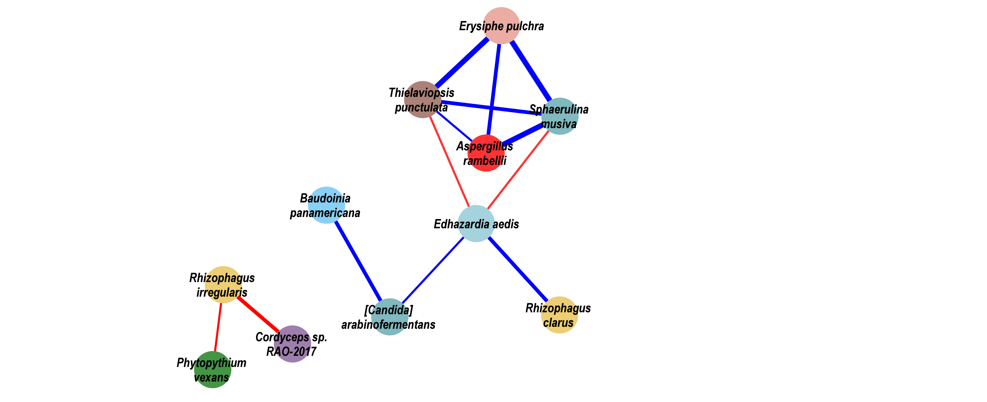
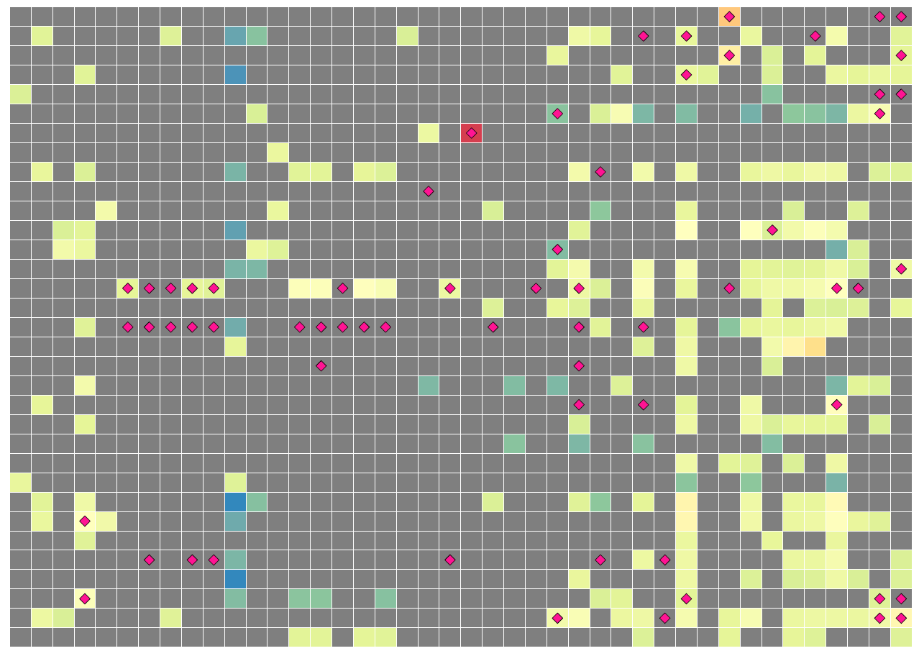
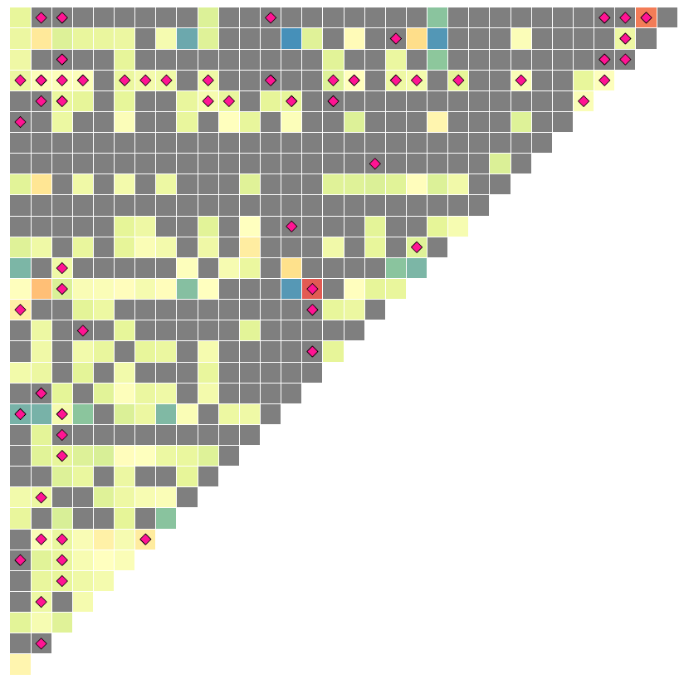
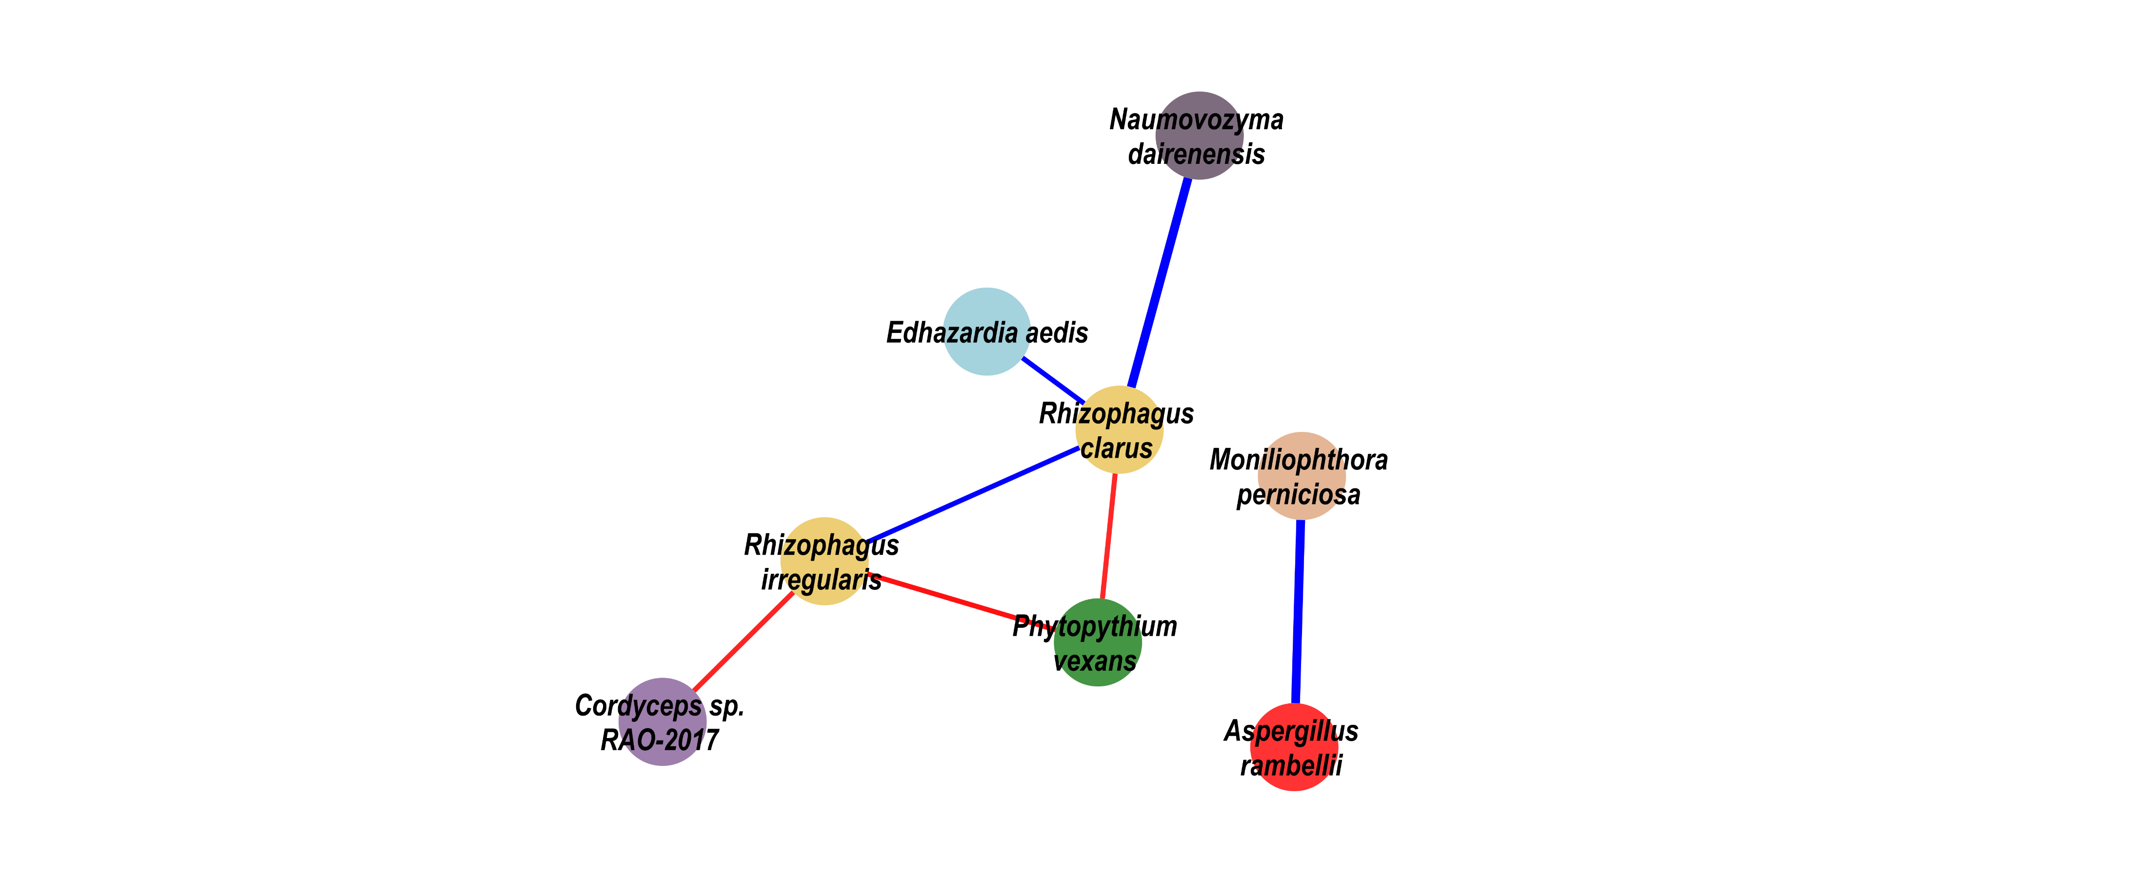
Eukaryota Interaction in CRC group
-0.20
0.00
0.25
0.50
0.70
Escherichia coli | Bifidobacterium longum | Ruminococcus bicirculans | Adlercreutzia equolifaciens | Bifidobacterium adolescentis | Streptococcus sp. HSISS2 | Streptococcus sp. HSISS3 | Streptococcus thermophilus | Streptococcus sp. FDAARGOS 192 | Streptococcus sp. HSISS1 | Prevotella intermedia | Alistipes sp. 3BBH6 | Bifidobacterium bifidum | Streptococcus sp. I−G2 | Streptococcus sp. JS71 | Streptococcus milleri | Streptococcus sp. A12 | Streptococcus sp. I−P16 | Streptococcus equinus | Bifidobacterium pseudocatenulatum | Streptococcus salivarius | Bifidobacterium angulatum | Lactobacillus ruminis | Bifidobacterium catenulatum | Streptococcus anginosus | Fusobacterium periodonticum | Clostridium beijerinckii | [Eubacterium] eligens | Porphyromonas asaccharolytica | Romboutsia ilealis | Brachyspira pilosicoli | Blautia sp. SC05B48 | Lactococcus garvieae | Dialister pneumosintes | Longibaculum sp. KGMB06250 | Roseburia intestinalis | Butyrivibrio proteoclasticus | Pseudobutyrivibrio xylanivorans | Anaerostipes hadrus | Gemella morbillorum | Parvimonas micra | Fusobacterium nucleatum
Choanephora cucurbitarum | Edhazardia aedis | Thielaviopsis punctulata | Tuber magnatum | Schizosaccharomyces pombe | Hyaloscypha variabilis | Baudoinia panamericana | [Candida] arabinofermentans | Colletotrichum salicis | Leucoagaricus sp. SymC.cos | Coniochaeta ligniaria | Colletotrichum fioriniae | Aspergillus ochraceoroseus | Phytopythium vexans | Naumovozyma dairenensis | Lipomyces starkeyi | Albugo candida | Paracoccidioides brasiliensis | Pichia kudriavzevii | Rhizophagus clarus | Cordyceps sp. RAO−2017 | Pseudocercospora musae | Trichoderma atroviride | Debaryomyces hansenii | Pneumocystis murina | Aspergillus kawachii | Trichophyton mentagrophytes | Phytophthora capsici | Sphaerulina musiva | Erysiphe pulchra | Moniliophthora perniciosa | Rhizophagus irregularis
Aspergillus rambellii
Rhizophagus irregularis
Moniliophthora perniciosa
Erysiphe pulchra
Sphaerulina musiva
Phytophthora capsici
Trichophyton mentagrophytes
Aspergillus kawachii
Pneumocystis murina
Debaryomyces hansenii
Trichoderma atroviride
Pseudocercospora musae
Cordyceps sp. RAO−2017
Rhizophagus clarus
Pichia kudriavzevii
Paracoccidioides brasiliensis
Albugo candida
Lipomyces starkeyi
Naumovozyma dairenensis
Phytopythium vexans
Aspergillus ochraceoroseus
Colletotrichum fioriniae
Coniochaeta ligniaria
Leucoagaricus sp. SymC.cos
Colletotrichum salicis
[Candida] arabinofermentans
Baudoinia panamericana
Hyaloscypha variabilis
Schizosaccharomyces pombe
Tuber magnatum
Thielaviopsis punctulata
Edhazardia aedis
Choanephora cucurbitarum
Eukaryota Interaction in Healthy control
Aspergillus rambellii
Rhizophagus irregularis
Moniliophthora perniciosa
Erysiphe pulchra
Sphaerulina musiva
Phytophthora capsici
Trichophyton mentagrophytes
Aspergillus kawachii
Pneumocystis murina
Debaryomyces hansenii
Trichoderma atroviride
Pseudocercospora musae
Cordyceps sp. RAO−2017
Rhizophagus clarus
Pichia kudriavzevii
Paracoccidioides brasiliensis
Albugo candida
Lipomyces starkeyi
Naumovozyma dairenensis
Phytopythium vexans
Aspergillus ochraceoroseus
Colletotrichum fioriniae
Coniochaeta ligniaria
Leucoagaricus sp. SymC.cos
Colletotrichum salicis
[Candida] arabinofermentans
Baudoinia panamericana
Hyaloscypha variabilis
Schizosaccharomyces pombe
Tuber magnatum
Thielaviopsis punctulata
Edhazardia aedis
Choanephora cucurbitarum
Notes:
F:\GitHub\multi-CRC-fungi\08.correlation

Slide 20
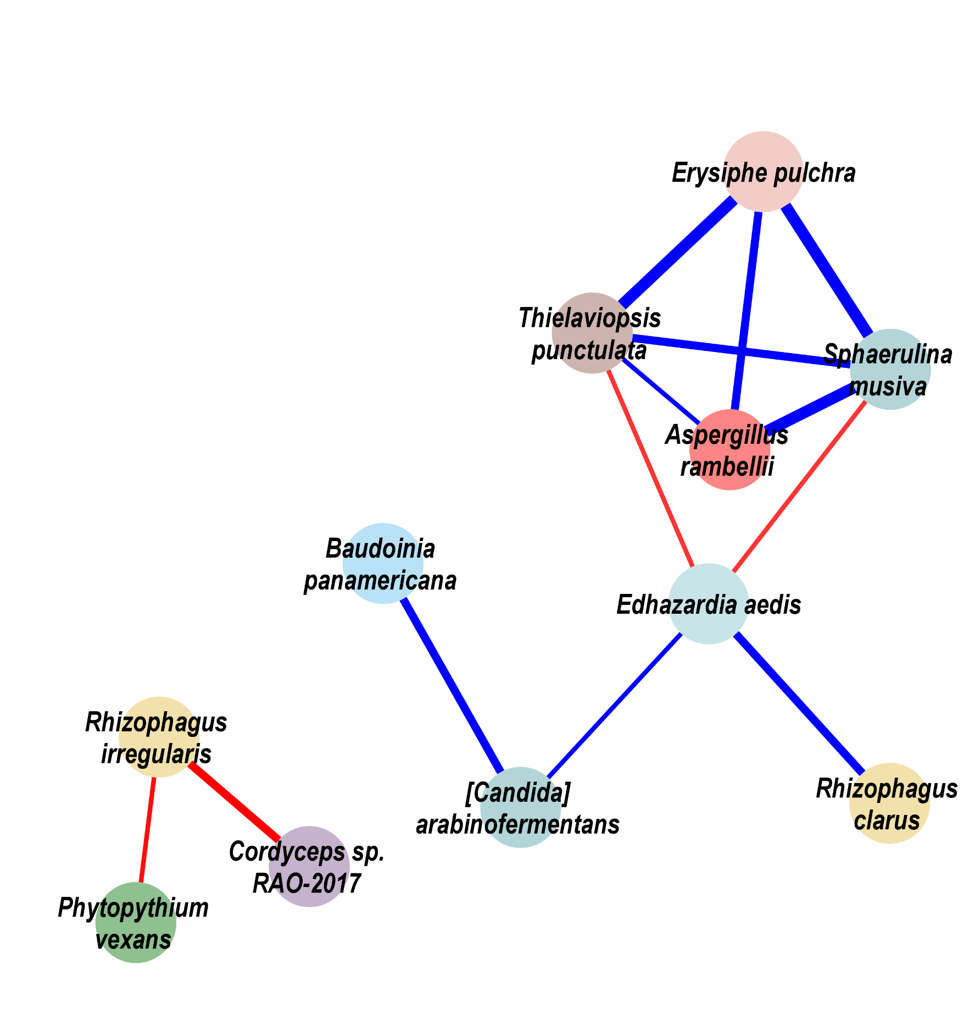
Eukaryota Interaction in CRC group
-0.20
0.00
0.25
0.50
0.70
Escherichia coli | Bifidobacterium longum | Ruminococcus bicirculans | Adlercreutzia equolifaciens | Bifidobacterium adolescentis | Streptococcus sp. HSISS2 | Streptococcus sp. HSISS3 | Streptococcus thermophilus | Streptococcus sp. FDAARGOS 192 | Streptococcus sp. HSISS1 | Prevotella intermedia | Alistipes sp. 3BBH6 | Bifidobacterium bifidum | Streptococcus sp. I−G2 | Streptococcus sp. JS71 | Streptococcus milleri | Streptococcus sp. A12 | Streptococcus sp. I−P16 | Streptococcus equinus | Bifidobacterium pseudocatenulatum | Streptococcus salivarius | Bifidobacterium angulatum | Lactobacillus ruminis | Bifidobacterium catenulatum | Streptococcus anginosus | Fusobacterium periodonticum | Clostridium beijerinckii | [Eubacterium] eligens | Porphyromonas asaccharolytica | Romboutsia ilealis | Brachyspira pilosicoli | Blautia sp. SC05B48 | Lactococcus garvieae | Dialister pneumosintes | Longibaculum sp. KGMB06250 | Roseburia intestinalis | Butyrivibrio proteoclasticus | Pseudobutyrivibrio xylanivorans | Anaerostipes hadrus | Gemella morbillorum | Parvimonas micra | Fusobacterium nucleatum
Choanephora cucurbitarum | Edhazardia aedis | Thielaviopsis punctulata | Tuber magnatum | Schizosaccharomyces pombe | Hyaloscypha variabilis | Baudoinia panamericana | [Candida] arabinofermentans | Colletotrichum salicis | Leucoagaricus sp. SymC.cos | Coniochaeta ligniaria | Colletotrichum fioriniae | Aspergillus ochraceoroseus | Phytopythium vexans | Naumovozyma dairenensis | Lipomyces starkeyi | Albugo candida | Paracoccidioides brasiliensis | Pichia kudriavzevii | Rhizophagus clarus | Cordyceps sp. RAO−2017 | Pseudocercospora musae | Trichoderma atroviride | Debaryomyces hansenii | Pneumocystis murina | Aspergillus kawachii | Trichophyton mentagrophytes | Phytophthora capsici | Sphaerulina musiva | Erysiphe pulchra | Moniliophthora perniciosa | Rhizophagus irregularis
Aspergillus rambellii
Rhizophagus irregularis
Moniliophthora perniciosa
Erysiphe pulchra
Sphaerulina musiva
Phytophthora capsici
Trichophyton mentagrophytes
Aspergillus kawachii
Pneumocystis murina
Debaryomyces hansenii
Trichoderma atroviride
Pseudocercospora musae
Cordyceps sp. RAO−2017
Rhizophagus clarus
Pichia kudriavzevii
Paracoccidioides brasiliensis
Albugo candida
Lipomyces starkeyi
Naumovozyma dairenensis
Phytopythium vexans
Aspergillus ochraceoroseus
Colletotrichum fioriniae
Coniochaeta ligniaria
Leucoagaricus sp. SymC.cos
Colletotrichum salicis
[Candida] arabinofermentans
Baudoinia panamericana
Hyaloscypha variabilis
Schizosaccharomyces pombe
Tuber magnatum
Thielaviopsis punctulata
Edhazardia aedis
Choanephora cucurbitarum
Eukaryota Interaction in Healthy control
Aspergillus rambellii
Rhizophagus irregularis
Moniliophthora perniciosa
Erysiphe pulchra
Sphaerulina musiva
Phytophthora capsici
Trichophyton mentagrophytes
Aspergillus kawachii
Pneumocystis murina
Debaryomyces hansenii
Trichoderma atroviride
Pseudocercospora musae
Cordyceps sp. RAO−2017
Rhizophagus clarus
Pichia kudriavzevii
Paracoccidioides brasiliensis
Albugo candida
Lipomyces starkeyi
Naumovozyma dairenensis
Phytopythium vexans
Aspergillus ochraceoroseus
Colletotrichum fioriniae
Coniochaeta ligniaria
Leucoagaricus sp. SymC.cos
Colletotrichum salicis
[Candida] arabinofermentans
Baudoinia panamericana
Hyaloscypha variabilis
Schizosaccharomyces pombe
Tuber magnatum
Thielaviopsis punctulata
Edhazardia aedis
Choanephora cucurbitarum
Notes:
F:\GitHub\multi-CRC-fungi\08.correlation

Slide 21


Eukaryota Interaction in CRC group
Escherichia coli | Bifidobacterium longum | Ruminococcus bicirculans | Adlercreutzia equolifaciens | Bifidobacterium adolescentis | Streptococcus sp. HSISS2 | Streptococcus sp. HSISS3 | Streptococcus thermophilus | Streptococcus sp. FDAARGOS 192 | Streptococcus sp. HSISS1 | Prevotella intermedia | Alistipes sp. 3BBH6 | Bifidobacterium bifidum | Streptococcus sp. I−G2 | Streptococcus sp. JS71 | Streptococcus milleri | Streptococcus sp. A12 | Streptococcus sp. I−P16 | Streptococcus equinus | Bifidobacterium pseudocatenulatum | Streptococcus salivarius | Bifidobacterium angulatum | Lactobacillus ruminis | Bifidobacterium catenulatum | Streptococcus anginosus | Fusobacterium periodonticum | Clostridium beijerinckii | [Eubacterium] eligens | Porphyromonas asaccharolytica | Romboutsia ilealis | Brachyspira pilosicoli | Blautia sp. SC05B48 | Lactococcus garvieae | Dialister pneumosintes | Longibaculum sp. KGMB06250 | Roseburia intestinalis | Butyrivibrio proteoclasticus | Pseudobutyrivibrio xylanivorans | Anaerostipes hadrus | Gemella morbillorum | Parvimonas micra | Fusobacterium nucleatum
Choanephora cucurbitarum | Edhazardia aedis | Thielaviopsis punctulata | Tuber magnatum | Schizosaccharomyces pombe | Hyaloscypha variabilis | Baudoinia panamericana | [Candida] arabinofermentans | Colletotrichum salicis | Leucoagaricus sp. SymC.cos | Coniochaeta ligniaria | Colletotrichum fioriniae | Aspergillus ochraceoroseus | Phytopythium vexans | Naumovozyma dairenensis | Lipomyces starkeyi | Albugo candida | Paracoccidioides brasiliensis | Pichia kudriavzevii | Rhizophagus clarus | Cordyceps sp. RAO−2017 | Pseudocercospora musae | Trichoderma atroviride | Debaryomyces hansenii | Pneumocystis murina | Aspergillus kawachii | Trichophyton mentagrophytes | Phytophthora capsici | Sphaerulina musiva | Erysiphe pulchra | Moniliophthora perniciosa | Rhizophagus irregularis
Aspergillus rambellii
Rhizophagus irregularis
Moniliophthora perniciosa
Erysiphe pulchra
Sphaerulina musiva
Phytophthora capsici
Trichophyton mentagrophytes
Aspergillus kawachii
Pneumocystis murina
Debaryomyces hansenii
Trichoderma atroviride
Pseudocercospora musae
Cordyceps sp. RAO−2017
Rhizophagus clarus
Pichia kudriavzevii
Paracoccidioides brasiliensis
Albugo candida
Lipomyces starkeyi
Naumovozyma dairenensis
Phytopythium vexans
Aspergillus ochraceoroseus
Colletotrichum fioriniae
Coniochaeta ligniaria
Leucoagaricus sp. SymC.cos
Colletotrichum salicis
[Candida] arabinofermentans
Baudoinia panamericana
Hyaloscypha variabilis
Schizosaccharomyces pombe
Tuber magnatum
Thielaviopsis punctulata
Edhazardia aedis
Choanephora cucurbitarum
Eukaryota Interaction in Healthy control
Aspergillus rambellii
Rhizophagus irregularis
Moniliophthora perniciosa
Erysiphe pulchra
Sphaerulina musiva
Phytophthora capsici
Trichophyton mentagrophytes
Aspergillus kawachii
Pneumocystis murina
Debaryomyces hansenii
Trichoderma atroviride
Pseudocercospora musae
Cordyceps sp. RAO−2017
Rhizophagus clarus
Pichia kudriavzevii
Paracoccidioides brasiliensis
Albugo candida
Lipomyces starkeyi
Naumovozyma dairenensis
Phytopythium vexans
Aspergillus ochraceoroseus
Colletotrichum fioriniae
Coniochaeta ligniaria
Leucoagaricus sp. SymC.cos
Colletotrichum salicis
[Candida] arabinofermentans
Baudoinia panamericana
Hyaloscypha variabilis
Schizosaccharomyces pombe
Tuber magnatum
Thielaviopsis punctulata
Edhazardia aedis
Choanephora cucurbitarum
0.70
Bacteria
Reported potential
probiotic
Asperillaceae
Ceratocystidaceae
Choanephoraceae
0.50
Reported potential
pathogens
Erysiphaceae
Glomeraceae
Hyaloscyphaceae
0.25
Bacteria
CRC Enriched
Eukaryota
Pichiaceae
Pythiaceae
Saccharomycetaceae
0.00
Eukaryota
Culicosporidae
Mycosphaerallaceae
Cordycipitaceae
-0.20
Eukaryota
CRC Depleted
Eukaryota
Marasmiaceae
Teratosphaeriaceae
Notes:
F:\GitHub\multi-CRC-fungi\08.correlation

Slide 22
0.4
0.06
0.06
0.04
0.04
0.3
0.02
0.02
0.00
-10
0
10
20
30
0.00
-10
0
10
20
30
0.2
0.3
0.2
0.1
0.1
0.0
-10
0
10
20
30
0.0
-10
0
10
20
30
70
60
40
41
20
28
18
18
10
9
12
12
0
1
1
0
6
1
0
6
0
0
+/+
+/0
0/+
0/-
-/+
-/0

Slide 23

Density Plot with z-score in various kingdom features
z-score represents the relative strength of differential correlation
0.4
0.06
0.04
0.02
0.3
0.00
-10
0
10
20
30
0.06
0.2
0.04
0.02
0.1
0.00
-10
0
10
20
30
0.3
0.2
0.0
0.1
-10
0
10
20
30
0.0
-10
0
10
20
30
Definition of differential correlation classes
Counts of differential correlation classes with various features
Feature Pair Correlation in CRC
Feature Pair Correlation in control
70
ρ > 0
p < 0.05
p > 0.05
ρ < 0
p < 0.05
60
ρ > 0
p < 0.05
+/+ $$z score ∈(−∞, +∞)$$ | +/0 $$z score ∈(−∞, 0)$$ | +/- $$z score ∈(−∞, 0)$$
0/+ $$z score ∈(0, +∞)$$ | 0/0 $$z score without$$ $$meaning$$ | 0/- $$z score ∈(−∞, 0)$$
-/+ $$z score ∈(0, +∞)$$ | -/0 $$z score ∈(0, +∞)$$ | -/- $$z score ∈(−∞, +∞)$$
41
p > 0.05
40
28
20
10
9
18
12
18
12
ρ < 0
p < 0.05
0
0
1
1
0
6
1
0
6
0
+/+
+/0
0/+
0/-
-/+
-/0

Slide 24


Import OTU matrix
(analysis by the kraken2 & bracken)
$${\log_{2}{FC}}_{i}=\log_{2}{\sum_{j=1}^{n_{crc}}{\sum_{k=1}^{n_{ctrl}}{\frac{{ReAbund}_{j i}}{{ReAbund}_{k i}}}}}$$
$${SSTF}_{i Enriched}=\sum_{n_{cohort}}^{cohort}{\left\{\begin{aligned}{\log_{2}{FC}}_{i n_{cohort}}>0 , 1 \\ {\log_{2}{FC}}_{i n_{cohort}}≤0, 0\end{aligned}\right.}$$
$${SSTF}_{i Depleted}=\sum_{n_{cohort}}^{cohort}{\left\{\begin{aligned}{\log_{2}{FC}}_{i n_{cohort}}>0 , 0 \\ {\log_{2}{FC}}_{i n_{cohort}}≤0, 1\end{aligned}\right.}$$
${SSTF}_{i Enriched / Depleted}>6$would be selected
SSTF
(selected same trend features)
$$i: fungi names$$
$$n_{crc}:counts of CRC samples$$
Significant difference
(Wilcoxon rank test: p value < 0.05)
28 fungi leave
Internal correlations
Log2(General Fold Change) > 1/2
$${\log_{2}{FC}}_{i}=\log_{2}{\sum_{j=1}^{n_{crc}}{\sum_{k=1}^{n_{ctrl}}{\frac{{ReAbund}_{j i}}{{ReAbund}_{k i}}}}}$$
${\log_{2}{FC}}_{i}>\frac{1}{2}$would be selected
Fungi
Aspergillus rambellii
Tilletia controversa
Aspergillus kawachii
Rhizophagus irregularis
Torulaspora globosa
Eremothecium sinecaudum
6 fungi leave
Bacteria analysis
candidates

Slide 25


























































































Aspergillus rambellii
8 cohorts has same trend in CRC entiched.
7 cohorts play significant different.
Stage
CTRL
CRC
1.2
p = 0.0018
p = 6.1e−05
p = 2.7e−05
p = 0.0034
p = 1.4e−06
p = 7.5e−05
p = 0.001
0.8
0.4
0.0
Tilletia controversa
7 cohorts has same trend in CRC entiched.
4 cohorts play significant different.
0.3
p = 0.00026
p = 0.0037
p = 9.3e−07
p = 0.0036
0.2
0.1
0.0
Aspergillus kawachii
7 cohorts has same trend in CRC depleted.
5 cohorts play significant different.
0.2
p = 0.02
p = 0.021
p = 0.012
p = 0.0039
p = 0.0018
0.1
0.0
Rhizophagus irregularis
1.00
p = 7.6e−05
7 cohorts has same trend in CRC depleted.
6 cohorts play significant different.
0.75
0.50
p = 7.9e−07
p = 0.029
p = 0.00085
p = 0.026
p = 3.5e−05
0.25
0.00
Torulaspora globosa
p = 0.0025
p = 0.0095
p = 0.0043
7 cohorts has same trend in CRC depleted.
4 cohorts play significant different.
0.20
p = 1.8e−05
0.15
0.10
0.05
0.00
Eremothecium sinecaudum
7 cohorts has same trend in CRC depleted.
4 cohorts play significant different.
0.2
p = 0.03
p = 0.008
p = 0.017
p = 0.0042
0.1
0.0
2014_ZellerG
2015_FengQ
2016_VogtmannE
2019_Thom
2019_WirbelJ
2019_Yachida
2021_JunY_1
2021_JunY_2

Slide 26


Aspergillus rambellii
Tilletia controversa Aspergillus kawachii Rhizophagus irregularis Torulaspora globosa Eremothecium sinecaudum
−2.5
0.0
Log2(FC)
2.5
5.0
CRC Enriched
CRC Depleted
Aspergillus rambellii
A. rambellii have been shown to accumulate both aflatoxin (AF) and the aflatoxin precursor sterigmatocystin (ST).^{[1]}
A. rambellii secreted a greater concentration of AFB1 than any other aflatoxigenic species. ^{[2]}
Aflatoxins are the most carcinogenic natural products known. ^{[2]}
Aspergillus kawachii
In the present study, fermented silkworm larvae was developed via solid-state fermentation with Aspergillus kawachii and investigated its anti-cancer activity in human hepatocellular carcinoma cells. ^{[3]}
Viscum album var. coloratum (Korean mistletoe; KM) is a promising agent for treating colon cancer, ^{[4, 6]} hepatoma and immunomodulation. The anti-oxidative activities of KM can be enhanced by fermentation using the crude enzyme extract derived from A. kawachii. ^{[5]}
Cary JW, Ehrlich KC, Beltz SB, Harris-Coward P, Klich MA. Characterization of the Aspergillus ochraceoroseus aflatoxin/sterigmatocystin biosynthetic gene cluster. Mycologia. 2009;101(3):352-362. doi:10.3852/08-173
Frisvad JC, Skouboe P, Samson RA. Taxonomic comparison of three different groups of aflatoxin producers and a new efficient producer of aflatoxin B1, sterigmatocystin and 3-O-methylsterigmatocystin, Aspergillus rambellii sp. nov. Syst Appl Microbiol. 2005;28(5):442-453. doi:10.1016/j.syapm.2005.02.012
Cho HD, Min HJ, Won YS, Ahn HY, Cho YS, Seo KI. Solid state fermentation process with Aspergillus kawachii enhances the cancer-suppressive potential of silkworm larva in hepatocellular carcinoma cells. BMC Complement Altern Med. 2019;19(1):241. Published 2019 Sep 5. doi:10.1186/s12906-019-2649-7
Khil, L. Y., Kim, W., Lyu, S., Park, W. B., Yoon, J. W., & Jun, H. S. (2007). Mechanisms involved in Korean mistletoe lectin-induced apoptosis of cancer cells. World journal of gastroenterology, 13(20), 2811–2818. https://doi.org/10.3748/wjg.v13.i20.2811
Kim, S. Y., Yang, E. J., Son, Y. K., Yeo, J. H., & Song, K. S. (2016). Enhanced anti-oxidative effect of fermented Korean mistletoe is originated from an increase in the contents of caffeic acid and lyoniresinol. Food & function, 7(5), 2270–2277. https://doi.org/10.1039/c6fo00138f
Khil, L. Y., Kim, W., Lyu, S., Park, W. B., Yoon, J. W., & Jun, H. S. (2007). Mechanisms involved in Korean mistletoe lectin-induced apoptosis of cancer cells. World journal of gastroenterology, 13(20), 2811–2818. https://doi.org/10.3748/wjg.v13.i20.2811

Slide 27

Weak internal correlation between the (selected) fungi
SparCC:
cohort
stage
Max |cor|
Max |cor| of A.R.
Sample counts
Counts(|cor| > 0.08)

